Slide 1
The Sustained Patient-centered Alcohol-Related Care (SPARC) Trial:
A cluster-randomized implementation trial in primary care
Katharine A. Bradley, MD, MPH
Amy K. Lee, MPH
Emily C. Williams, PhD, MPH
AHSR 2019
Park City Utah, October 17, 2019
Notes:
Hello and welcome everyone to our symposium, The Sustained Patient-centered Alcohol-Related Care (SPARC) Trial: A cluster-randomized implementation trial in primary care.

Slide 2
Thanks to:
Collaborators
Research Funding
Carol E. Achtmeyer, ARNP, MN
Jennifer F. Bobb, PhD
Evette J. Ludman, PhD
Julie E. Richards, PhD, MPH
Madeline C. Frost, MPH
Theresa E. Matson, MPH
Malia Oliver
Chester Pabiniak
Ryan M. Caldeiro, MD
Rebecca Parrish, LICSW, MSW
Joseph E. Glass, PhD, MSW
Paula Lozano, MD, MPH
  Agency for Healthcare Research and Quality (AHRQ) R18 HS023173 - SPARC Trial
  NIAAA K24 AA022128 (Bradley)
  NIAAA K01 AA023859 (Glass)
AHRQ – R18 HS027076– Michigan SPARC
NIAAA R21 AA023037 Options Study (AUD decision aid)
Other Support
  KP Washington
  Washington Health Alliance
  VA Puget Sound
  University of Washington
Notes:
First I’d like to thank our collaborators, and our research funding and support, specifically the Agency for Healthcare Research and Quality which funded our main SPARC trial and analyses.

Slide 3
Introduction

Slide 4
Background
Agency for Healthcare Research and Quality (AHRQ) RFA 2013: sustained implementation of evidence-based primary care
We proposed: Sustained Patient-centered Alcohol Related Care (SPARC) Trial
Notes:
In 2013, the U.S. Agency for Healthcare Research and Quality put out an RFA for sustained implementation of evidence-based primary care practices. We proposed the SPARC trial – Sustained Patient-centered Alcohol Related Care.

Slide 5
Background
Evidence-based prevention and treatment of unhealthy alcohol use in primary care
  Screening and brief intervention (SBI)
  Treatment for alcohol use disorders (AUDs)
  USPSTF: Jonas Ann Intern Med 2012; Moyer Ann Intern Med 2013;
  (USPSTF 2018: O’Connor Ann Intern Med 2018)
  Anton JAMA 2006; Ernst Ann Fam Med 2008
  Jonas JAMA 2014; Bradley, Kivlahan JAMA 2014
Notes:
Evidence-based care for unhealthy alcohol use in primary care includes screening and brief intervention and treatment for alcohol use disorders including medications, medication management, and linkage to counseling and specialty alcohol treatment

Slide 6
SPARC Aims
Specific Aims
To increase the proportion of PC patients who have unhealthy alcohol use identified and brief intervention (BI) offered
To increase the proportion of PC patients who have an AUD recognized and are engaged in alcohol-related treatment.
Notes:
The SPARC trial had two main aims. The first was to increase the proportion of primary care patients who have unhealthy alcohol use identified and brief intervention offered. The second aim was to increase the proportion of primary care patients who have an alcohol use disorder recognized and are engaged in alcohol-related care , as defined by the National Committee for Quality Assurance (or NCQA), an organization that develops quality measures for health systems.

Slide 7
Outline
Overview
Intervention and qualitative results - Lee
Main SPARC trial results - Bradley
Evaluation with patient surveys – Williams
Conclusion and Discussion
Notes:
So for today’s presentations, I will be sharing more about the enhanced model of practice coaching used in our trial; Dr. Bradley will debut our main trial results, and Dr. Williams will present on a secondary evaluation of the SPARC implementation intervention describing patient-reported alcohol advice

Slide 8
Overview

Slide 9
SPARC Trial: Setting
Pragmatic implementation trial
January 2015 - July 2018
Kaiser Permanente Washington
25 primary care sites
  Bobb IJERPH 2017; Glass Implementation Science 2018
Notes:
The trial took place in Kaiser Permanente Washington from January 2015 through July 2018. Implementation strategies included practice coaching, electronic health record (EHR) clinical decision support, and performance monitoring and feedback to local implementation teams. The sample included all patients seen for primary care across 25 sites during the study period . All measures relied on secondary data from EHR or insurance claims. The main outcome measure for prevention was documented brief intervention (BI) within 14 days of a positive AUDIT-C screen. Natural language processing and procedure codes were used to identify documented BI. The main outcome measure for AUD treatment was initiation and engagement in treatment, defined based on the US National Committee of Quality Assurance Healthcare Effectiveness Dataset Information System measures , requiring a visit with an AUD diagnosis within 14 days of initial diagnosis, with 2 more visits in the next 30 days . Analyses were conducted consistent with CONSORT for cluster-randomized trials (including intention to treat). We used general linear mixed models accounting for correlation of measures in the same person or site, adjusted for age, gender, race, ethnicity, ETC.
Edit if results are only 22 randomized clinisc
22?
Delete?
Delete this whole citation/source clause, not strictly necessary?
Or if required to keep source, (and I know this is sacrilegious) shorten to some combo such as:
US National Committee of Quality Assurance measures (skips HEDIS)
US Healthcare Effectiveness Dataset Information System (skip NCQA)
Should this be ‘for’? I’m not sure what is meant by ‘requiring a visit with an AUD diagnosis’
Or delete/shorten! 😊
“requiring a visit within 14 days of initial AUD diagnosis”
May not fit

Slide 10
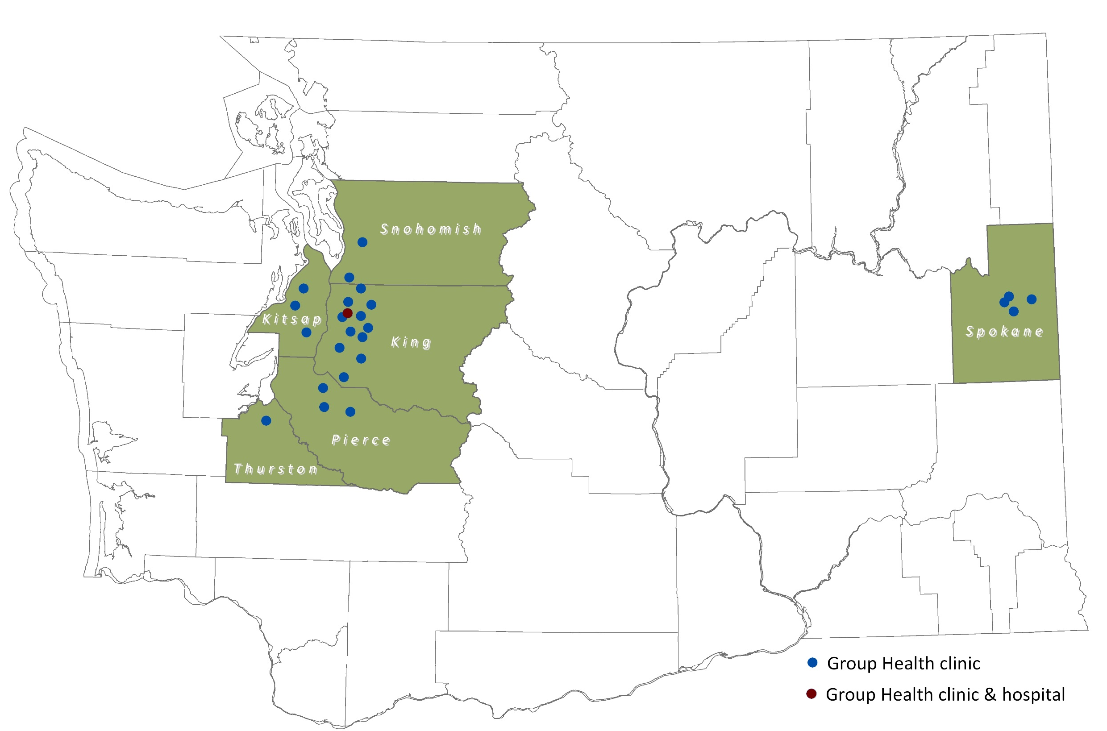
SPARC Trial: Setting

Slide 11
SPARC Trial: Setting
25 primary care sites
  3 site pilot
  Stepped-wedge trial: 22 PC sites
IRB: waivers of consent & HIPAA
  Bobb IJERPH 2017; Glass Implementation Science 2018
Notes:
The trial took place in Kaiser Permanente Washington from January 2015 through July 2018. Implementation strategies included practice coaching, electronic health record (EHR) clinical decision support, and performance monitoring and feedback to local implementation teams. The sample included all patients seen for primary care across 25 sites during the study period . All measures relied on secondary data from EHR or insurance claims. The main outcome measure for prevention was documented brief intervention (BI) within 14 days of a positive AUDIT-C screen. Natural language processing and procedure codes were used to identify documented BI. The main outcome measure for AUD treatment was initiation and engagement in treatment, defined based on the US National Committee of Quality Assurance Healthcare Effectiveness Dataset Information System measures , requiring a visit with an AUD diagnosis within 14 days of initial diagnosis, with 2 more visits in the next 30 days . Analyses were conducted consistent with CONSORT for cluster-randomized trials (including intention to treat). We used general linear mixed models accounting for correlation of measures in the same person or site, adjusted for age, gender, race, ethnicity, ETC.
Edit if results are only 22 randomized clinisc
22?
Delete?
Delete this whole citation/source clause, not strictly necessary?
Or if required to keep source, (and I know this is sacrilegious) shorten to some combo such as:
US National Committee of Quality Assurance measures (skips HEDIS)
US Healthcare Effectiveness Dataset Information System (skip NCQA)
Should this be ‘for’? I’m not sure what is meant by ‘requiring a visit with an AUD diagnosis’
Or delete/shorten! 😊
“requiring a visit within 14 days of initial AUD diagnosis”
May not fit

Slide 12
SPARC Implementation Trial
Clinical care: Alcohol-related clinical care we were aiming to increase
SPARC intervention: implementation strategies we used to implement that clinical care
  Bobb IJERPH 2017; Glass Implementation Science 2018
  https://www.youtube.com/watch?v=tbKbq2IytC4

Slide 13
SPARC Alcohol-related Clinical Care
Prevention
  Alcohol screening
  Preventive counseling: unhealthy alcohol use
Treatment AUDs
  DSM-5 symptom checklist (0-11): if high risk
  Initiation of AUD treatment
  Engagement in treatment
  Bobb IJERPH 2017; Glass Implementation Science 2018
  https://www.youtube.com/watch?v=tbKbq2IytC4

Slide 14
SPARC Implementation Intervention
Three Implementation Strategies
Two used previously in VA: screening and BI
  EHR tools
  Performance monitoring and feedback
In VA’s 900 sites
  High rates of documented screening and BI
  Gaps in screening quality (61% missed)
  Neglected adopters
    Bradley Am J Manag Care 2006; Lapham Med Care 2012
    Bradley JGIM 2011; Chavez JSAD 2016; Berger JGIM 2018
    Greenhalgh Milbank Q 2004; Williams & Bradley ASAM Textbook 2013

Slide 15
SPARC Implementation Intervention
Three Implementation Strategies
  EHR tools
  Performance monitoring and feedback
  Practice coaching
  Bobb IJERPH 2017; Glass Implementation Science 2018
  https://www.youtube.com/watch?v=tbKbq2IytC4

Slide 16
SPARC Trial: Practice Coaching
Practice coaching addressed:
  Workflow
  Knowledge
  Stigma
Small iterative pilot tests to overcome resistance
Framing:
  Whole spectrum of alcohol-related care
  Patient-centered shared decision-making
    Greenhalgh Milbank quarterly 2004;
    Williams & Bradley ASAM Textbook 2013
  Bobb IJERPH 2017; Glass Implementation Science 2018
Notes:
Hemming, K., K. Carroll, J. Thompson, A. Forbes, M. Taljaard and S.-C. r. group (2018). "Quality of stepped-wedge trial reporting can be reliably assessed using an updated CONSORT: crowd-sourcing systematic review." J Clin Epidemiol.
Hemming, K., M. Taljaard and A. Forbes (2018). "Modeling clustering and treatment effect heterogeneity in parallel and stepped-wedge cluster randomized trials." Stat Med 37(6): 883-898.
Hemming, K., M. Taljaard, J. E. McKenzie, R. Hooper, A. Copas, J. A. Thompson, M. Dixon-Woods, A. Aldcroft, A. Doussau, M. Grayling, C. Kristunas, C. E. Goldstein, M. K. Campbell, A. Girling, S. Eldridge, M. J. Campbell, R. J. Lilford, C. Weijer, A. B. Forbes and J. M. Grimshaw (2018). "Reporting of stepped wedge cluster randomised trials: extension of the CONSORT 2010 statement with explanation and elaboration." BMJ 363: k1614.
Hughes, J. P., T. S. Granston and P. J. Heagerty (2015). "Current issues in the design and analysis of stepped wedge trials." Contemp Clin Trials 45(Pt A): 55-60.
Hussey, M. A. and J. P. Hughes (2007). "Design and analysis of stepped wedge cluster randomized trials." Contemp Clin Trials 28(2): 182-191.
Hussey, M. A. and J. P. Hughes (2007). "Design and analysis of stepped wedge cluster randomized trials." Contemp Clin Trials 28(2): 182-191.
One thing to point out is that I noticed a few places where the results from our pre-specified generalized linear mixed effect model (GLMM) that includes a random intercept for both site and person was very different from the corresponding generalized linear model (GLM) that does not include the random intercepts. This occurred for a few outcomes (namely trt_outcome_main) where the model claims to have converged, but the inconsistently with the GLM results makes me very skeptical. I've tried running other optimization algorithms but many of them failed to converge. As I've mentioned, the model is complicated to fit because it has 2 different random effects and the dataset is really large (~1.4 million records).

Slide 17
SPARC Trial – Design
Pragmatic Trial of Alcohol SBI and Shared Decision-Making for Alcohol Use Disorders
Duration: months | 3 | 12 | 4 | 4 | 4 | 4 | 4 | 4
Preparation
Pilot – 3 clinics |  | Pilot
Wave 1 – 3 clinics |  |  | 1
Wave 2 – 3 clinics |  |  |  | 2
Wave 3 – 3 clinics |  |  |  |  | 3
Wave 4 – 3-4 clinics |  |  |  |  |  | 4
Wave 5 – 3-4 clinics |  |  |  |  |  |  | 5
Wave 6 – 3-4 clinics |  |  |  |  |  |  |  | 6
Wave 7 – 3-4 clinics |  |  |  |  |  |  |  |  | 7
Notes:
Here is a schematic of the trial, and you’ll see that each new wave of randomized clinics started implementation every 4 months.

Slide 18
SPARC Trial: Setting
Group Health – 2014 ….
  Financially stressed
  Leadership changes
  Decreased PC staffing → low morale
  Little or no quality infrastructure in PC
  Dec. 2015 (end of pilot): acquisition announced
  March 2017: Acquired by Kaiser
  Bobb IJERPH 2017; Glass Implementation Science 2018
Notes:
There were also some unique challenges in our health system.
There were limited EHR decision support tools and data to support care and monitor quality.
The health system was defining the goal of improving alcohol-related care in the context of behavioral health integration and clinical teams weren’t necessarily identifying this as a gap.
And, at the time of roll out, our health system was financially stressed, which led to:
Decreased primary care staffing
Primary care leadership changes
Low morale
No quality improvement practices in primary care.
Lastly, when we finished our pilot year, it was announced that our health system would be acquired, and leaders only agreed to the first year of the trial.

Slide 19
SPARC Trial: Setting
  Usual Care
  Screening with AUDIT-C: 19%
  No systematic assessment for AUD
  Some electronic health record (EHR) tools
    Provider documentation templates
    After visit summaries for patients
  No meaningful performance monitoring
    None for SBI
    NCQA HEDIS alcohol & other drug measure
  Bobb IJERPH 2017; Glass Implementation Science 2018
Notes:
Prior to SPARC, usual alcohol-related care included alcohol screening with the AUDIT-C, which was at a rate of 19%, and screening was only completed at annual wellness visits and ad-hoc by providers. There was no systematic way to assess for alcohol use disorder. Some electronic health record tools to support alcohol-related care were developed with the clinical guidelines for unhealthy alcohol use in adult patients, including provider documentation templates and after visit summaries for patients. There was no performance monitoring and feedback for screening and brief intervention, and although our health system used a national measure for AUD treatment initiation, the data were not actively fed back to primary care clinics

Slide 20
SPARC Trial: Partners
  2013: Partner on grant — Director Primary Care
  Bobb IJERPH 2017; Glass Implementation Science 2018
Notes:
By the time we received funding for the trial, our original partner, the Director of Primary Care, had left. The Director of Behavioral Health agreed to partner with us to roll out alcohol-related care in primary care, and he also asked us to include parallel care for depression and suicidal ideation, as well as cannabis, and other drugs as part of a larger Behavioral Health Integration initiative. Although we thought that this would increase the complexity and burden on primary care, we also thought this would increase the relative value of the work to our health system stakeholders, as well as increase synergy and efficiency. We agreed to use the same implementation strategies planned for our trial to roll out this larger Behavioral Health Integration initiative, with no additional funding.

Slide 21
SPARC Trial: Partners
Implement all
  2013: Partner on grant — Director of Primary Care
  2014: Director, Primary Care had left
    Partnered with the Director Behavioral Health
    Implement all of Behavioral Health Integration
    Able to get permission for pilot only
  2015: Pilot: 3 sites
    Value of social workers trained in SUDs recognized → staffing with integrated behavioral health clinicians
  Bobb IJERPH 2017; Glass Implementation Science 2018
Notes:
By the time we received funding for the trial, our original partner, the Director of Primary Care, had left. The Director of Behavioral Health agreed to partner with us to roll out alcohol-related care in primary care, and he also asked us to include parallel care for depression and suicidal ideation, as well as cannabis, and other drugs as part of a larger Behavioral Health Integration initiative. Although we thought that this would increase the complexity and burden on primary care, we also thought this would increase the relative value of the work to our health system stakeholders, as well as increase synergy and efficiency. We agreed to use the same implementation strategies planned for our trial to roll out this larger Behavioral Health Integration initiative, with no additional funding.

Slide 22
BHI Clinical Care
Screen
Assess
Prevention, Shared decision making & treatment
Monitor and Adapt
7-Item Paper Screen
PHQ-2
AUDIT-C
Cannabis
Drugs
Notes:
Demo scren
Dx assessment
Columbia
Preventive HO
Getting started

Slide 23
BHI Clinical Care
Screen
Assess
Prevention, Shared decision making & treatment
Monitor and Adapt
7-Item Paper Screen
PHQ-2
AUDIT-C
Cannabis
Drugs
4 Possible Assessments
PHQ-9
Suicide risk assessment
Alcohol Symptom Checklist (SC)
Substance use SC
Notes:
Set up JG re 7-12 AUDIT-C

Slide 24
BHI Clinical Care
Screen
Assess
Prevention, Shared decision making & treatment
Monitor and Adapt
7-Item Paper Screen
PHQ-2
AUDIT-C
Cannabis
Drugs
4 Possible Assessments
PHQ-9
Suicide risk assessment
Alcohol Symptom Checklist (SC)
Substance use SC
BI or Shared decision-making & Treatment:
Depression/
Anxiety
AUD
Other SUDs
Notes:
Demo scren
Dx assessment
Columbia
Preventive HO
Getting started

Slide 25
BHI Clinical Care
Screen
Assess
Prevention, Shared decision making & treatment
Monitor and Adapt
7-Item Paper Screen
PHQ-2
AUDIT-C
Cannabis
Drugs
Monitoring
Tool:
PHQ-9
GAD-2
AUDIT-C
Cannabis
Drugs
4 Possible Assessments
PHQ-9
Suicide risk assessment
Alcohol Symptom Checklist (SC)
Substance use SC
BI or shared decision-making & Treatment:
Depression/
Anxiety
AUD
Other SUDs
Notes:
Demo scren
Dx assessment
Columbia
Preventive HO
Getting started

Slide 26
SPARC Trial: Partners
  2016: Permission for year 1
    Leaders selected 9 sites
  2017: Permission for year 2-3
    6 sites clustered into 3 pairs
  Bobb IJERPH 2017; Glass Implementation Science 2018
Notes:
By the time we received funding for the trial, our original partner, the Director of Primary Care, had left. The Director of Behavioral Health agreed to partner with us to roll out alcohol-related care in primary care, and he also asked us to include parallel care for depression and suicidal ideation, as well as cannabis, and other drugs as part of a larger Behavioral Health Integration initiative. Although we thought that this would increase the complexity and burden on primary care, we also thought this would increase the relative value of the work to our health system stakeholders, as well as increase synergy and efficiency. We agreed to use the same implementation strategies planned for our trial to roll out this larger Behavioral Health Integration initiative, with no additional funding.

Slide 27
Intervention

Slide 28
Overview
Design of intervention
Focus on unique expanded coaching role
Overview of qualitative results
Notes:
For this next section of the presentation, I’m going to be focusing on the design of the intervention, the unique expanded practice coaching role, and an overview of qualitative results based on formative evaluation.

Slide 29
Design of the Intervention
Developed with front line teams
Pilots in 3 clinics: 2015
Each clinic: 3-day “design events”
Quality improvement meetings
Notes:
The design of the intervention was developed with interdisciplinary front-line teams in a 3-clinic pilot in 2015 where we had 3-day design events. These design events included a full day of design, and the second two days alternated huddles and piloting with scheduled primary care visits to work out the work flow. These were followed with weekly to monthly quality improvement meetings.

Slide 30
SPARC Implementation Intervention
EHR Tools
Performance Feedback
PC Team
Practice Coach
Notes:
30
The SPARC implementation intervention included three implementation strategies to support front line primary care teams. These were:
Electronic decision support tools in our EHR
Performance monitoring and feedback
And a practice coach to support primary care teams with clinical care content, stigma reduction, development and refinement of workflow, and quality improvement.

Slide 31
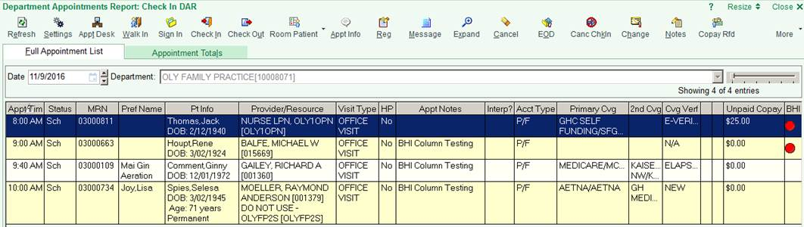
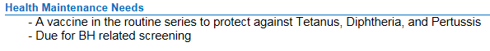
EHR Prompts: Annual Screening
For check-in staff:
For medical assistant & PCP dyads:
Notes:
I’m going to show you some screenshots of our prompts just so you get a sense of what these look like. You likely won’t be able to read all the text. Here’s an example of how check-in staff and medical assistants were prompted to give patients a paper-based annual screen

Slide 32
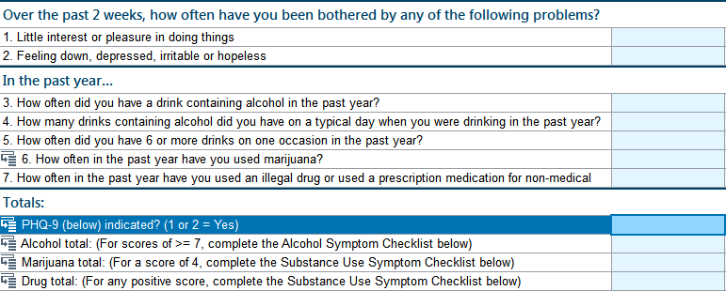
AUDIT-C in EHR
Notes:
Medical Assistants entered screening results, including the AUDIT-C, in the EHR during their rooming process.

Slide 33
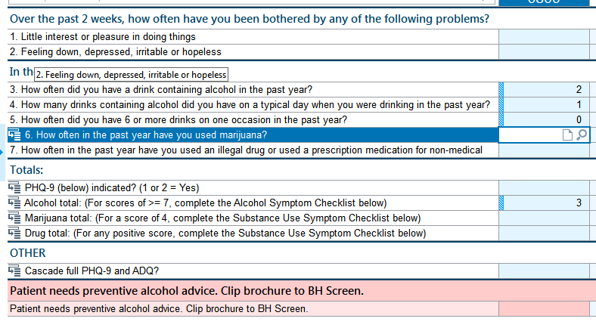
Prompt for MA to give alcohol handout
Notes:
When AUDIT-C scores were 3 or more for women or 4 or more for men, there was an automated prompt for Medical Assistants to pull out an alcohol handout for providers to cue them that brief alcohol counseling was needed for the patient.

Slide 34
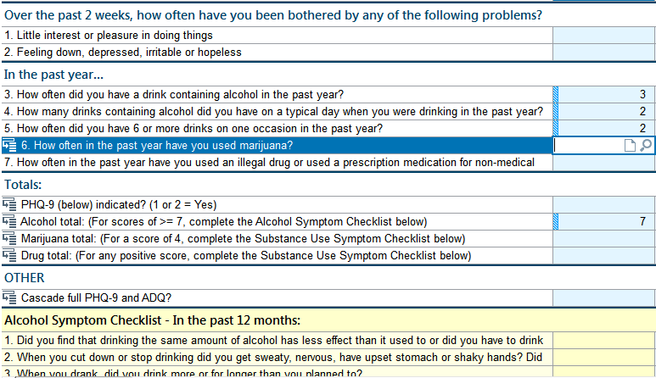
Prompt for MA to give Alcohol Symptom Checklist
Notes:
And if patients scored a 7 or more on the AUDIT-C, there was an automated prompt for Medical Assistants to give patient an 11-item Alcohol Use Disorder symptom checklist

Slide 35
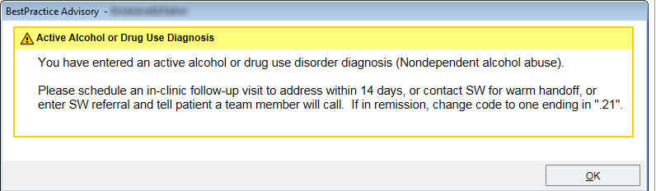
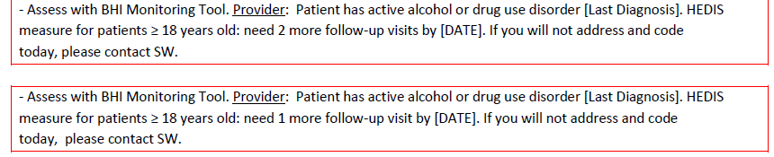
Prompts for AUD Treatment
Best Practice Alert (BPA)
Pre-visit summary prompts:
Notes:
We also had EHR prompts for alcohol and drug use disorder treatment. This included a best practice alert for treatment initiation at the time of new diagnosis, and pre-visit summary prompts for treatment engagement.

Slide 36
Performance Feedback – Alcohol
Weekly, provider- and clinic-level
  Screening rate
  Assessment rate
Monthly, provider- and clinic-level
  NCQA HEDIS alcohol or drug treatment initiation
Notes:
Performance feedback included weekly feedback at the provider- and clinic-level included AUDIT-C screening rates for all adult primary care patients and assessment with the AUD symptom checklist for patients with an AUDIT-C score of 7 or more.
For treatment, the NCQA HEDIS measure for alcohol or drug treatment initiation was provided at the provider- and clinic-level monthly.

Slide 37
Performance Feedback – Alcohol
No support obtained for feedback of
Evidence-based treatment of AUD
  Behavioral treatment
  Medication
  Specialty treatment
AUD treatment engagement
Notes:
Although our research team developed performance feedback measures that included evidence-based treatment for AUD, including behavioral, medication, and specialty treatment, we were not able to gain traction with using the data. We also did not have health system support for providing feedback of AUD treatment engagement.

Slide 38
Practice Coaching
Efficacious in improving implementation of evidence-based in primary care
Bridge gap between research and practice
Work with a clinic over time
Support quality improvement efforts
Tailor work to needs of a practice
Nagykaldi 2005; Baskerville 2012; Taylor 2013
Notes:
The remainder of my time will focus on our practice coaching implementation strategy and how practice coaching intersected with the other implementation strategies.
Practice coaches, also called practice facilitators or quality improvement consultants, have been shown through systematic reviews and meta-analyses to be efficacious in improving implementation of evidence-based guidelines in primary care. Practice coaches are often used to bridge the gap between research and evidence-based practice. They work with a clinic over time to support quality improvement efforts and to tailor evidence-based care to the needs of a practice.

Slide 39

Typical Practice Coaching
PC Teams
Clinical expertise
Clinical culture
Identify gaps in care
Notes:
Typically, primary care teams hold the clinical expertise and knowledge of their clinical culture, and teams lead practice improvement by identifying the gaps in their clinical care.

Slide 40

Typical Practice Coaching
PC Teams
Coaches
Clinical expertise
Clinical culture
Prioritize QI activities
Build capacity for change
Enhance team dynamics
Redesign workflows/ processes
Train staff to use data to drive QI
Promote effective communication
Identify gaps in care
Center of Excellence in Primary Care and Care Oregon, 2016
Notes:
Practice coaches bring their practice improvement processes skills to help teams apply their clinical knowledge to make changes.
These skills include:
Helping teams prioritize quality improvement (QI) activities
Building capacity for change
Enhancing team dynamics
Working with teams to redesign workflows and processes
Training staff to understand and use data to drive QI, and
Promoting effective communication skills

Slide 41
Unique challenges to alcohol-related care
Primary care teams did not have clinical expertise around alcohol:
  Preventive routine screening and brief intervention
  Treatment options: medications, counseling, specialty alcohol treatment
Stigma
Not seen as part of primary care
Notes:
However, our practice coaching had to be enhanced from this typical model of practice coaching. In designing our practice coaching model, we had to take into consideration some unique challenges to implementing evidence-based alcohol-related care into primary care. This included that
Primary care teams often do not have the clinical expertise around preventive alcohol screening and brief interventions nor knowledge about treatment options for alcohol use disorders, including medications, counseling, and specialty alcohol treatment
There is considerable amount of stigma around alcohol
And therefore alcohol-related care is often not been seen as part of primary care

Slide 42
Where we started
We don’t have enough time or resources to do this.
Whose idea was this?
We are too overwhelmed. This is opening up Pandora’s box.
This is a research project that others committed to and now we are being forced to prioritize it.
42
Notes:
So when we started working with the clinical teams, many were upset because we were asking them to do more, especially during a time when staffing was being reduced.
What we heard from clinic teams when we first started (which might be familiar to many of you trying to implement change) included:
We don’t have enough time or resources to do this
Whose idea was this?
We are too overwhelmed. This is opening up Pandora’s box.
This is a research project that others (leaders) committed to, and now we are being forced to prioritize it.

Slide 43
Implementation: 4 Phases Each Clinic
Months
Variable | 1 | 2 | 3 | 4 | 5 | 6 | Variable
Phase 1 | Phase 2 |  | Phase 3 |  |  |  | Phase 4
Usual Care | Preparation |  | Active Implementation |  |  |  | Sustainment
Randomly assigned launch date:
EHR prompts turned on for clinic
Notes:
Despite this discontent, with our health system partners’ support, we were able to ask for clinical time to implement this work, likely because we were rolling out this larger initiative of behavioral health integration and not just alcohol-related care. Here is a timeline for each clinic, where each clinic had 4 phases: a usual care phase, a preparation phase, and after the randomly assigned launch date when EHR prompts were turned on for the clinic, an active implementation and a sustainment phase. I will go over how practice coaching fits into these different phases.

Slide 44
Implementation: 4 Phases Each Clinic
Clinic leadership meeting (3 months before kickoff)
Months
Variable | 1 | 2 | 3 | 4 | 5 | 6 | Variable
Phase 1 | Phase 2 |  | Phase 3 |  |  |  | Phase 4
Usual Care | Preparation |  | Active Implementation |  |  |  | Sustainment
Notes:
Roll out started with a meeting with clinic leadership during the usual care phase. This was usually 2-3 months before a kick-off meeting and the purpose was to talk with clinic leaders about identifying local implementation team members, and to discuss implementation schedule.

Slide 45
SPARC Practice Coaching
6 months of scheduled meetings
Local quality improvement team (QIT)
  Clinic Leadership
  Dyad(s): PCP and medical assistant (MA)
  Front desk staff
  Social worker(s)
  RN(s)
Notes:
We outlined the 6 months of meetings between the practice coach and the local quality improvement team at each site. And each site’s team consisted of an interdisciplinary team comprised of the primary care chief and manager, Provider and Medical Assistant dyads, Front desk check-in staff, Social worker: integrated behavioral health specialist in primary care, and Nurse

Slide 46
Implementation: 4 Phases Each Clinic
Clinic leadership meeting (3 months before kickoff)
3-hour kickoff meeting with local QIT, followed by weekly meetings
Months
Variable | 1 | 2 | 3 | 4 | 5 | 6 | Variable
Phase 1 | Phase 2 |  | Phase 3 |  |  |  | Phase 4
Usual Care | Preparation |  | Active Implementation |  |  |  | Sustainment
Notes:
During the preparation phase, coaches led a 2.5-3 hour kick off meeting with the local implementation team to give an overview of the evidence-based clinical work and workflow, with a goal for the team to start piloting right after.

Slide 47
Implementation: 4 Phases Each Clinic
Clinic leadership meeting (3 months before kickoff)
3-hour kickoff meeting with local QIT, followed by weekly meetings
Two 1-hour trainings
All PC staff and provider training
Separately PCP/RN and MA/check-in staff
Months
Variable | 1 | 2 | 3 | 4 | 5 | 6 | Variable
Phase 1 | Phase 2 |  | Phase 3 |  |  |  | Phase 4
Usual Care | Preparation |  | Active Implementation |  |  |  | Sustainment
Notes:
Coaches also led trainings during the preparation phase, which included a 1-hour all primary care training, and separately a one hour primary care provider and RN training as well as a 1-hour medical assistant and check-in staff training.
.

Slide 48
Implementation: 4 Phases Each Clinic
Clinic leadership meeting (3 months before kickoff)
3-hour kickoff meeting with local QIT, followed by weekly meetings
Two 1-hour trainings:
All PC staff and provider training
Separately PCP/RN and MA/check-in staff
Months
Variable | 1 | 2 | 3 | 4 | 5 | 6 | Variable
Phase 1 | Phase 2 |  | Phase 3 |  |  |  | Phase 4
Usual Care | Preparation |  | Active Implementation |  |  |  | Sustainment
Weekly PDCA cycle meetings through month 5, then decreasing per clinic preference.
BHI leaders joined meetings monthly.
Notes:
Following the kick-off meeting, coaches met with the local quality improvement teams weekly for an hour. The quality improvement meetings were plan-do-check-adjust cycle, or PDCA cycle meetings. During the preparation phase, the focus of the meetings was to refine work flow, plan for a full clinic launch, and improve clinical knowledge. Weekly hourly PDCA meetings continued for the 3 months after launch during active implementation, using performance feedback data to drive quality improvement. Our health system partners, the Behavioral health integration leaders, joined these meetings monthly, and these weekly meetings generally ramped down around the last month of active implementation.
At the last PDCA meeting with leaders, practice coaches handed off support for the clinics to BHI leaders.

Slide 49



Adaptation with Enhanced Practice Coaching Model
EHR Tools Team
Programmer & Operations
Clinical Teams
Coaches
Research Data Team
Health System & Research Leaders
Notes:
Now I will focus on how we adapted the practice coaching model for the SPARC trial. As with usual practice coaching, the practice coaches’ primary relationship was with the clinic teams. But in order to overcome the unique challenges in our trial and in the clinical care, and to empower the teams and give them the tools they needed, there needed to be a freeflowing pathway of feedback and development between the clinical teams and the health system and research leaders, our EHR development team, and our research data team developing the performance feedback. This led to a multi-pronged approach with the coach as the main link between all teams, grounded with the experience and perspective of the clinical teams.

Slide 50
Clinical Teams & Patient Care Stories
Coaches
Local stories important
Used to start meetings
Increased interest and motivation
Identified gaps: knowledge/workflow
Addressed stigma and stereotypes
Clinical Teams
Notes:
A central part of the coach’s work with the teams was to engage teams through sharing patient care stories. The staff’s interest and motivation increased as they heard positive stories about patients response to the new work. Although coaches would often bring stories of success from other clinics, the stories that really engaged the clinics were stories that emerged from their own patients. We incorporated sharing patient stories at the start of every meeting, which identified stories for the local implementation team to share with their larger clinic. Coaches also invited teams to share challenging stories to help identify gaps in knowledge or workflow, including opportunities to address stigma and stereotypes.
Some quick examples include a provider saying:
“I was surprised that when I recommended by patients cut down on alcohol, they did and felt better.” Or,
Or a provider describing how a patient came in for a wart removal and had it not been for BHI, she wouldn’t have known that the patient was suffering from depression and acutely suicidal.

Slide 51
Addressing Stigma and Stereotypes
Coaches
Knowledge → decreased stigma
Creating safe, non-judgmental space for patients to disclose
  “Everyone’s responsibility”
  “No wrong door”
  Scripting, neutral language: “Once a year, all patients, whole health”
Clinical Teams
Notes:
Also different from traditional practice coaching was that coaches in SPARC addressed stigma and stereotypes with the clinical teams. From the beginning, coaches integrated trainings around the spectrum of unhealthy alcohol, and this helped decrease stigma and address care teams’ own discomfort around talking about alcohol with patients.
We also worked with staff to create a safe, non judgmental space where patients would feel comfortable talking about their concerns about alcohol. It was essential that every primary care team member, from the check-in staff to the provider, saw this as their responsibility to create that space. We supported staff in developing the concept that there was no wrong door for patients to enter the health system to get care, including developing language on introducing screening so patients wouldn’t feel singled out. This included introducing screening as being done once a year for all patients for their whole health
Coaches also worked to create a safe non-judgmental space for clinical teams to understand their own stigma and how that affects patient care.

Slide 52

Notes:
Our research and operations team developed a youtube video with Mike Evans that gave an overview of alcohol and health to increase knowledge and address stereotypes about unhealthy alcohol use both for patients and care teams. The video was used in our first team meeting as well as in trainings for primary care teams. The video was also embedded into after visit summaries for patients.

Slide 53
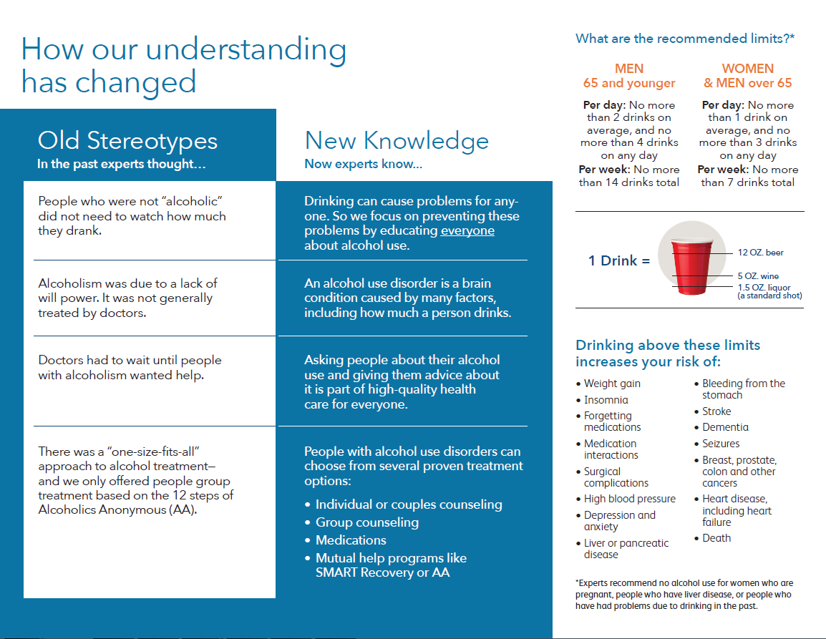
For BI
Notes:
Similarly, we developed an alcohol pamphlet to educate patients and primary care teams about unhealthy alcohol use. This handout was used as part of the brief intervention with patients, with this highlighted panel showing recommended limits and risks of drinking above limits.

Slide 54
Stigma Reduction
Notes:
The pamphlet also included a section on stigma reduction, addressing directly old stereotypes and new knowledge.

Slide 55
Integrating clinical knowledge
Coaches
Didactic and Workflow Content:
  Screening
  BI
  Diagnostic criteria for alcohol use disorders
  Treatment options
Empowered team members to teach
Additional trainings as requested
Training materials
Clinical Teams
Notes:
Another part of the coach’s work with the clinical teams was integrating clinical knowledge throughout meetings and trainings with the clinic teams. This was done in several ways – including didactic content around screening, brief intervention, how to diagnose alcohol use disorders, and evidence-based treatment options, several of which could be provided in the primary care setting. Once team members became more familiar with the clinical content and work flow, coaches empowered the team members to share and teach others. Practice coaches provided additional trainings or connected clinics to content experts for additional trainings. Coaches also developed training materials and job aids as a result of feedback from teams to have quick reference guides for clinical care.

Slide 56
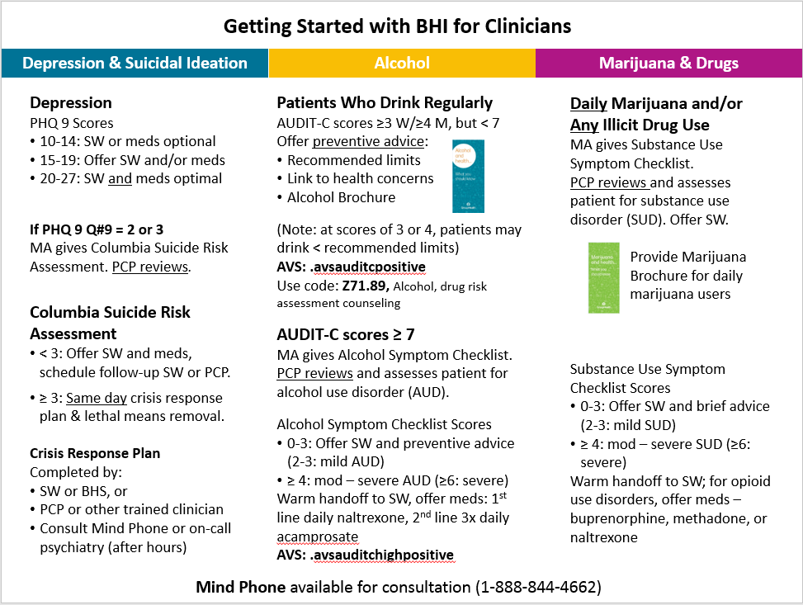
Notes:
This is an example of a job aid practices coaches developed for primary care providers to help them understand the clinical work at a glance; and you’ll notice that alcohol-related care is one of three sections in the document.

Slide 57
EHR decision support tools
Coaches
Weekly meetings: EHR team
  Improving & building EHR tools
  Identify “breaks” in EHR prompts
  Align EHR tools with workflow
  Harmonize EHR tools across system: mental health and urgent care
EHR Tools Team
Programmer & Operations
Notes:
As part of our model, coaches were connected to the EHR tools team through weekly meetings, working together to build tools the clinical teams needed. The clinic teams also helped to identify “breaks” in the EHR prompts and the coaches worked to align the tools to the clinical workflow and to harmonize tools across the whole health system with primary care, specifically the mental health and urgent care departments

Slide 58
Performance feedback
Coaches
Meetings with the data team
  Provide data clinic teams need
  Identify erroneous data
  Design/formatting of data
Research Data Team
Notes:
Similarly, coaches met with the research data team about performance feedback to the clinics. This included iterative changes to essential data the clinic teams needed (for example, pulling provider-level data), identifying areas where the data pulls weren’t capturing all the data fields needed, and working on design and formatting of the performance feedback so the data could be easily digestible for the clinic teams.
Performance feedback
Design/formatting
MRNs
Provider-level data
Cascading monitoring tool → system leadership
Columbia cascade → system leadership

Slide 59
Connection with Leaders
Coaches
Weekly all team meetings
BHI Leaders
  Chief of addictions and consultative psychiatry
  Director of social work
Helped engage clinics at the start
Gave credibility
BHI Leaders
Research & Operations
Notes:
Last, the connection the coaches had to behavioral health leaders– the chief of addictions and the director social work-- was invaluable. Our weekly meetings with these leaders throughout the trial and their support around this work helped engage clinic leadership at the start, lent the work credibility.

Slide 60
Connection with Leaders
Coaches
Sustainment by handing off
  PDCA to leaders, quarterly
  Performance metrics
  Integration with new employee onboarding
  Rolling out to 5 new PC clinics
Led to system-level changes:
  Increased social work resources
  Tools translated to 16 languages
BHI Leaders
Research & Operations
Notes:
A major benefit of this connection to our delivery system partners is that after the 6-month period of support in each clinic, practice coaches were able to hand off the support of this work to the leaders. Our delivery system partners have taken on quarterly quality improvement PDCA cycle meetings with the primary care clinics and have continued to provide monthly performance feedback to the teams. In addition, they’ve made larger changes integrating training for new employees during onboarding, and they’ve been leading roll-out of this care into new primary care clinics that are being added in KPWA. This support also led to system-level changes, including increased social work resources in primary care, and additional translations of our tools into multiple languages.

Slide 61
Achievements
When PCPs were surveyed about 21 recent PC enhancements in 2018, BHI was ranked in top 5 for all elements of the quadruple aim:
  Patient experience
  Quality of care
  Decreasing costs
  Provider experience
Notes:
In 2018, as active implementation of SPARC in the context of Behavioral Health Integration was winding down, providers ranked behavioral health integration in the top 5 of 21 primary care investments to improve patient experience, quality of care, decrease costs, and improve provider experience.
PC clinician perceptions
July-August 2018
PC providers survey: 21 “PC investments”
130/435 (30%) responded
Behavioral Health Integration in the top 5
Impact on patient experience: 2nd (44%)
Impact on provider experience: 5th (27%)
Improved quality: 3rd (38%)
Decreased costs: 4th (17%)

Slide 62
System Response
I wouldn’t go back to providing care the way I used to if they asked me to.
The best roll-out of any program I’ve experienced.
I felt empowered to help this patient when she was in need.
One of the best things that has happened to my primary care practice…this is just how we do primary care now.
Notes:
Nearing the end of our trial, the response from our clinic teams had changed. At the end of active implementation support, we heard providers, clinic support staff, and leaders telling us:

Slide 63
Main SPARC Trial Results

Slide 64
Sustained Patient-centered Alcohol Related Care (SPARC) Trial
Specific Aims
To increase the proportion of PC patients who have unhealthy alcohol use identified and who are offered brief intervention
To increase the proportion of PC patients who have an AUD recognized and were engaged in alcohol-related treatment
  Bobb IJERPH 2017; Glass Implementation Science 2018
  USPSTF: Jonas Ann Intern Med 2012; Moyer Ann Intern Med 2013
  Jonas JAMA 2014; Bradley & Kivlahan JAMA 2014

Slide 65
SPARC Trial - Methods
Sample:
All patients seen in 22 primary care sites
2 groups: patients seen during
  Usual care period
  Intervention period
  Each site randomly assigned to a wave
  (and its associate start date)
  Bobb IJERPH 2017; Glass Implementation Science 2018
Notes:
The trial took place in Kaiser Permanente Washington from January 2015 through July 2018. Implementation strategies included practice coaching, electronic health record (EHR) clinical decision support, and performance monitoring and feedback to local implementation teams. The sample included all patients seen for primary care across 25 sites during the study period . All measures relied on secondary data from EHR or insurance claims. The main outcome measure for prevention was documented brief intervention (BI) within 14 days of a positive AUDIT-C screen. Natural language processing and procedure codes were used to identify documented BI. The main outcome measure for AUD treatment was initiation and engagement in treatment, defined based on the US National Committee of Quality Assurance Healthcare Effectiveness Dataset Information System measures , requiring a visit with an AUD diagnosis within 14 days of initial diagnosis, with 2 more visits in the next 30 days . Analyses were conducted consistent with CONSORT for cluster-randomized trials (including intention to treat). We used general linear mixed models accounting for correlation of measures in the same person or site, adjusted for age, gender, race, ethnicity, ETC.
Edit if results are only 22 randomized clinisc
22?
Delete?
Delete this whole citation/source clause, not strictly necessary?
Or if required to keep source, (and I know this is sacrilegious) shorten to some combo such as:
US National Committee of Quality Assurance measures (skips HEDIS)
US Healthcare Effectiveness Dataset Information System (skip NCQA)
Should this be ‘for’? I’m not sure what is meant by ‘requiring a visit with an AUD diagnosis’
Or delete/shorten! 😊
“requiring a visit within 14 days of initial AUD diagnosis”
May not fit

Slide 66
Implementation: 4 Phases Each Site
Months
Variable | 1 | 2 | 3 | 4 | 5 | 6 | Variable
Phase 1 Usual care | Phase 2 Preparation |  | Phase 3 Active Implementation |  |  |  | Phase 4 Sustainment
Schedule mtgs | Piloting w coaches |  | Meetings every 1-2 weeks with coaches |  |  |  | Quarterly PDCA
Randomly assigned launch date
EHR prompts on for adult PC patients

Slide 67
Implementation: 4 Phases Each Site
Months
Variable | 1 | 2 | 3 | 4 | 5 | 6 | Variable
Phase 1 Usual care | Phase 2 Preparation |  | Phase 3 Active Implementation |  |  |  | Phase 4 Sustainment
Schedule mtgs | Piloting w coaches |  | Meetings every 1-2 weeks with coaches |  |  |  | Quarterly PDCA
Randomly assigned launch date
EHR prompts on for adult PC patients

Slide 68
Implementation: 4 Phases Each Site
Usual Care
Months
Variable | 1 | 2 | 3 | 4 | 5 | 6 | Variable
Phase 1 Usual care | Phase 2 Preparation |  | Phase 3 Active Implementation |  |  |  | Phase 4 Sustainment
Schedule mtgs | Piloting w coaches |  | Meetings every 1-2 weeks with coaches |  |  |  | Quarterly PDCA
Randomly assigned launch date
EHR prompts on for adult PC patients

Slide 69
Implementation: 4 Phases Each Site
Intervention
Months
Variable | 1 | 2 | 3 | 4 | 5 | 6 | Variable
Phase 1 Usual care | Phase 2 Preparation |  | Phase 3 Active Implementation |  |  |  | Phase 4 Sustainment
Schedule mtgs | Piloting w coaches |  | Meetings every 1-2 weeks with coaches |  |  |  | Quarterly PDCA
Randomly assigned launch date
EHR prompts on for adult PC patients

Slide 70
SPARC Trial: Data Collection
All secondary electronic data
EHR data
  Screen and assessment
  ICD and other codes (v,z, HCSPCS)
  Pharmacy
  Insurance claims
  ICD and CPT codes
  Pharmacy
  Bobb IJERPH 2017; Glass Implementation Science 2018
Notes:
The trial took place in Kaiser Permanente Washington from January 2015 through July 2018. Implementation strategies included practice coaching, electronic health record (EHR) clinical decision support, and performance monitoring and feedback to local implementation teams. The sample included all patients seen for primary care across 25 sites during the study period . All measures relied on secondary data from EHR or insurance claims. The main outcome measure for prevention was documented brief intervention (BI) within 14 days of a positive AUDIT-C screen. Natural language processing and procedure codes were used to identify documented BI. The main outcome measure for AUD treatment was initiation and engagement in treatment, defined based on the US National Committee of Quality Assurance Healthcare Effectiveness Dataset Information System measures , requiring a visit with an AUD diagnosis within 14 days of initial diagnosis, with 2 more visits in the next 30 days . Analyses were conducted consistent with CONSORT for cluster-randomized trials (including intention to treat). We used general linear mixed models accounting for correlation of measures in the same person or site, adjusted for age, gender, race, ethnicity, ETC.
Edit if results are only 22 randomized clinisc
22?
Delete?
Delete this whole citation/source clause, not strictly necessary?
Or if required to keep source, (and I know this is sacrilegious) shorten to some combo such as:
US National Committee of Quality Assurance measures (skips HEDIS)
US Healthcare Effectiveness Dataset Information System (skip NCQA)
Should this be ‘for’? I’m not sure what is meant by ‘requiring a visit with an AUD diagnosis’
Or delete/shorten! 😊
“requiring a visit within 14 days of initial AUD diagnosis”
May not fit

Slide 71
SPARC Trial: Main Outcomes
Two Main Outcomes:
  Assessed in entire PC sample
  (i.e. NOT in patients who needed the care)
  To avoid identification bias
  Measures per 28 day period
  Bobb IJERPH 2017; Glass Implementation Science 2018
  J. Bobb et. al. Designing to avoid identification bias, NIH Collaboratory ltextbook
  https://rethinkingclinicaltrials.org/chapters/design/experimental-designs-randomization-schemes-top/designing-to-avoid-identification-bias/
Notes:
The trial took place in Kaiser Permanente Washington from January 2015 through July 2018. Implementation strategies included practice coaching, electronic health record (EHR) clinical decision support, and performance monitoring and feedback to local implementation teams. The sample included all patients seen for primary care across 25 sites during the study period . All measures relied on secondary data from EHR or insurance claims. The main outcome measure for prevention was documented brief intervention (BI) within 14 days of a positive AUDIT-C screen. Natural language processing and procedure codes were used to identify documented BI. The main outcome measure for AUD treatment was initiation and engagement in treatment, defined based on the US National Committee of Quality Assurance Healthcare Effectiveness Dataset Information System measures , requiring a visit with an AUD diagnosis within 14 days of initial diagnosis, with 2 more visits in the next 30 days . Analyses were conducted consistent with CONSORT for cluster-randomized trials (including intention to treat). We used general linear mixed models accounting for correlation of measures in the same person or site, adjusted for age, gender, race, ethnicity, ETC.
Edit if results are only 22 randomized clinisc
22?
Delete?
Delete this whole citation/source clause, not strictly necessary?
Or if required to keep source, (and I know this is sacrilegious) shorten to some combo such as:
US National Committee of Quality Assurance measures (skips HEDIS)
US Healthcare Effectiveness Dataset Information System (skip NCQA)
Should this be ‘for’? I’m not sure what is meant by ‘requiring a visit with an AUD diagnosis’
Or delete/shorten! 😊
“requiring a visit within 14 days of initial AUD diagnosis”
May not fit

Slide 72
SPARC Trial: Main Outcomes
1. Prevention: brief intervention
  Positive AUDIT-C screen and
  Documented counseling or advice
  Based on
    Natural language processing
    Billing codes
    At visit or within 14 days
  Bobb IJERPH 2017; Glass Implementation Science 2018
Notes:
The trial took place in Kaiser Permanente Washington from January 2015 through July 2018. Implementation strategies included practice coaching, electronic health record (EHR) clinical decision support, and performance monitoring and feedback to local implementation teams. The sample included all patients seen for primary care across 25 sites during the study period . All measures relied on secondary data from EHR or insurance claims. The main outcome measure for prevention was documented brief intervention (BI) within 14 days of a positive AUDIT-C screen. Natural language processing and procedure codes were used to identify documented BI. The main outcome measure for AUD treatment was initiation and engagement in treatment, defined based on the US National Committee of Quality Assurance Healthcare Effectiveness Dataset Information System measures , requiring a visit with an AUD diagnosis within 14 days of initial diagnosis, with 2 more visits in the next 30 days . Analyses were conducted consistent with CONSORT for cluster-randomized trials (including intention to treat). We used general linear mixed models accounting for correlation of measures in the same person or site, adjusted for age, gender, race, ethnicity, ETC.
Edit if results are only 22 randomized clinisc
22?
Delete?
Delete this whole citation/source clause, not strictly necessary?
Or if required to keep source, (and I know this is sacrilegious) shorten to some combo such as:
US National Committee of Quality Assurance measures (skips HEDIS)
US Healthcare Effectiveness Dataset Information System (skip NCQA)
Should this be ‘for’? I’m not sure what is meant by ‘requiring a visit with an AUD diagnosis’
Or delete/shorten! 😊
“requiring a visit within 14 days of initial AUD diagnosis”
May not fit

Slide 73
SPARC Trial: Main Outcomes
2. Alcohol Treatment
  New AUD diagnosis documented at visit and
  Evidence of AUD treatment
    Based on ICD codes (NCQA HEDIS AOD)
    Initiation: 1st visit within 14 days
    Engagement: 2 more within next 30 days
  Bobb IJERPH 2017; Glass Implementation Science 2018
Notes:
US National Committee of Quality Assurance Healthcare Effectiveness Dataset Information System measures
, requiring a visit with an AUD diagnosis within 14 days of initial diagnosis, with 2 more visits in the next 30 days . 22?
Delete?
Delete this whole citation/source clause, not strictly necessary?
Or if required to keep source, (and I know this is sacrilegious) shorten to some combo such as:
US National Committee of Quality Assurance measures (skips HEDIS)
US Healthcare Effectiveness Dataset Information System (skip NCQA)
Should this be ‘for’? I’m not sure what is meant by ‘requiring a visit with an AUD diagnosis’
Or delete/shorten! 😊
“requiring a visit within 14 days of initial AUD diagnosis”
May not fit

Slide 74
SPARC Trial: Secondary Outcomes
Intermediate outcomes (e.g. screening)
Secondary outcomes –sensitivity analyses to assess assumptions about
    Time frames
    Definitions, e.g. telephone visits included?
Notes:
Today: pilot data, qualitative data, and metrics

Slide 75
SPARC Trial: Main Analyses
Describe sample: usual care vs. intervention
Interrupted time series, descriptive re: screening
Descriptive: treatment cascades
  Bobb IJERPH 2017; Glass Implementation Science 2018
  Hemming KM Stat Med 2018; Hemming KM BMJ 2018

Slide 76
SPARC Trial: Analyses
Main analyses compared 2 main outcomes
    Usual Care vs. Intervention
Consistent with CONSORT for cluster-randomized and stepped-wedge trial
    Intention to treat (start date randomly assigned)
  Bobb IJERPH 2017; Glass Implementation Science 2018
Notes:
Hemming, K., K. Carroll, J. Thompson, A. Forbes, M. Taljaard and S.-C. r. group (2018). "Quality of stepped-wedge trial reporting can be reliably assessed using an updated CONSORT: crowd-sourcing systematic review." J Clin Epidemiol.
Hemming, K., M. Taljaard and A. Forbes (2018). "Modeling clustering and treatment effect heterogeneity in parallel and stepped-wedge cluster randomized trials." Stat Med 37(6): 883-898.
Hemming, K., M. Taljaard, J. E. McKenzie, R. Hooper, A. Copas, J. A. Thompson, M. Dixon-Woods, A. Aldcroft, A. Doussau, M. Grayling, C. Kristunas, C. E. Goldstein, M. K. Campbell, A. Girling, S. Eldridge, M. J. Campbell, R. J. Lilford, C. Weijer, A. B. Forbes and J. M. Grimshaw (2018). "Reporting of stepped wedge cluster randomised trials: extension of the CONSORT 2010 statement with explanation and elaboration." BMJ 363: k1614.
Hughes, J. P., T. S. Granston and P. J. Heagerty (2015). "Current issues in the design and analysis of stepped wedge trials." Contemp Clin Trials 45(Pt A): 55-60.
Hussey, M. A. and J. P. Hughes (2007). "Design and analysis of stepped wedge cluster randomized trials." Contemp Clin Trials 28(2): 182-191.
Hussey, M. A. and J. P. Hughes (2007). "Design and analysis of stepped wedge cluster randomized trials." Contemp Clin Trials 28(2): 182-191.
One thing to point out is that I noticed a few places where the results from our pre-specified generalized linear mixed effect model (GLMM) that includes a random intercept for both site and person was very different from the corresponding generalized linear model (GLM) that does not include the random intercepts. This occurred for a few outcomes (namely trt_outcome_main) where the model claims to have converged, but the inconsistently with the GLM results makes me very skeptical. I've tried running other optimization algorithms but many of them failed to converge. As I've mentioned, the model is complicated to fit because it has 2 different random effects and the dataset is really large (~1.4 million records).

Slide 77
SPARC Trial: Analyses
General linear mixed models (GLMM)
    Random effects for patient and site
    Accounts for correlation (same person & site)
    Adjusted for
    Time: calendar month
    Stratification variable: Year 1 vs 2-3
  Bobb IJERPH 2017; Glass Implementation Science 2018
Notes:
Hemming, K., K. Carroll, J. Thompson, A. Forbes, M. Taljaard and S.-C. r. group (2018). "Quality of stepped-wedge trial reporting can be reliably assessed using an updated CONSORT: crowd-sourcing systematic review." J Clin Epidemiol.
Hemming, K., M. Taljaard and A. Forbes (2018). "Modeling clustering and treatment effect heterogeneity in parallel and stepped-wedge cluster randomized trials." Stat Med 37(6): 883-898.
Hemming, K., M. Taljaard, J. E. McKenzie, R. Hooper, A. Copas, J. A. Thompson, M. Dixon-Woods, A. Aldcroft, A. Doussau, M. Grayling, C. Kristunas, C. E. Goldstein, M. K. Campbell, A. Girling, S. Eldridge, M. J. Campbell, R. J. Lilford, C. Weijer, A. B. Forbes and J. M. Grimshaw (2018). "Reporting of stepped wedge cluster randomised trials: extension of the CONSORT 2010 statement with explanation and elaboration." BMJ 363: k1614.
Hughes, J. P., T. S. Granston and P. J. Heagerty (2015). "Current issues in the design and analysis of stepped wedge trials." Contemp Clin Trials 45(Pt A): 55-60.
Hussey, M. A. and J. P. Hughes (2007). "Design and analysis of stepped wedge cluster randomized trials." Contemp Clin Trials 28(2): 182-191.
Hussey, M. A. and J. P. Hughes (2007). "Design and analysis of stepped wedge cluster randomized trials." Contemp Clin Trials 28(2): 182-191.
One thing to point out is that I noticed a few places where the results from our pre-specified generalized linear mixed effect model (GLMM) that includes a random intercept for both site and person was very different from the corresponding generalized linear model (GLM) that does not include the random intercepts. This occurred for a few outcomes (namely trt_outcome_main) where the model claims to have converged, but the inconsistently with the GLM results makes me very skeptical. I've tried running other optimization algorithms but many of them failed to converge. As I've mentioned, the model is complicated to fit because it has 2 different random effects and the dataset is really large (~1.4 million records).

Slide 78
Results

Slide 79
Results: Sample
 | Usual Care & Preparation | Intervention Active/Sustain
Number of patients | 255,801 | 228,270
Visit/patient, mean (sd) | 3.73 (3.75) | 2.70 (2.62)
Age, years, mean (sd) | 49 (18) | 50 (18)
Female (%) | 58.5 | 59.3
Notes:
24% and 22%

Slide 80
Results: Sample
 | Usual Care & Preparation | Intervention Active/Sustain
Number of patients | 255,801 | 228,270
Visit/patient, mean (sd) | 3.73 (3.75) | 2.70 (2.62)
Age, years, mean (sd) | 49 (18) | 50 (18)
Female (%) | 58.5 | 59.3
Notes:
24% and 22%

Slide 81
Results: Sample
 | Usual Care & Preparation | Intervention Active/Sustain
Number of patients | 255,801 | 228,270
Visit/patient, mean (sd) | 3.73 (3.75) | 2.70 (2.62)
Age, years, mean (sd) | 49 (18) | 50 (18)
Female (%) | 58.5 | 59.3
Notes:
24% and 22%

Slide 82
Results: Sample
 | Usual Care (& Preparation) | Intervention (Active/Sustain)
Hispanic | 5.9 | 5.9
Race (%)
Asian | 9.7 | 10.9
Black/AA | 5.7 | 5.5
Hawaiian/Pacific I. | 1.1 | 1.0
Native American | 0.8 | 0.7
Multiple | 3.1 | 3.0
Other | 3.6 | 3.8
Unknown | 3.8 | 4.7
White | 72.2 | 70.4
Notes:
24% and 22%

Slide 83
Results: Sample
 | Usual Care (& Preparation) | Intervention (Active/Sustain)
Hispanic | 5.9 | 5.9
Race (%)
Asian | 9.7 | 10.9
Black/AA | 5.7 | 5.5
Hawaiian/Pacific I. | 1.1 | 1.0
Native American | 0.8 | 0.7
Multiple | 3.1 | 3.0
Other | 3.6 | 3.8
Unknown | 3.8 | 4.7
White | 72.2 | 70.4
Notes:
24% and 22%

Slide 84
Results: Sample
 | Usual Care (& Preparation) | Intervention (Active/Sustain)
Hispanic | 5.9 | 5.9
Race (%)
Asian | 9.7 | 10.9
Black/AA | 5.7 | 5.5
Hawaiian/Pacific I. | 1.1 | 1.0
Native American | 0.8 | 0.7
Multiple | 3.1 | 3.0
Other | 3.6 | 3.8
Unknown | 3.8 | 4.7
White | 72.2 | 70.4
Notes:
24% and 22%

Slide 85
Results: Sample
 | Usual Care & Preparation | Intervention Active/Sustain
Insurance(%)
Commercial | 61.0 | 56.4
Medicaid | 3.6 | 3.1
Medicare | 22.7 | 23.9
Other | 3.0 | 3.1
Private Pay | 9.4 | 13.5
Tobacco Past Yr (%) | 9.4 | 9.5
Notes:
24% and 22%

Slide 86
Results: Sample
 | Usual Care & Preparation | Intervention Active/Sustain
Insurance(%)
Commercial | 61.0 | 56.4
Medicaid | 3.6 | 3.1
Medicare | 22.7 | 23.9
Other | 3.0 | 3.1
Private Pay | 9.4 | 13.5
Tobacco Past Yr (%) | 9.4 | 9.5
Notes:
24% and 22%

Slide 87
Results: Sample
 | Usual Care & Preparation | Intervention Active/Sustain
Insurance(%)
Commercial | 61.0 | 56.4
Medicaid | 3.6 | 3.1
Medicare | 22.7 | 23.9
Other | 3.0 | 3.1
Private Pay | 9.4 | 13.5
Tobacco Past Yr (%) | 9.4 | 9.5
Notes:
24% and 22%

Slide 88
Results: Sample
 | Usual Care & Preparation | Intervention Active/Sustain
Insurance(%)
Commercial | 61.0 | 56.4
Medicaid | 3.6 | 3.1
Medicare | 22.7 | 23.9
Other | 3.0 | 3.1
Private Pay | 9.4 | 13.5
Tobacco Past Yr (%) | 9.4 | 9.5
Notes:
24% and 22%

Slide 89
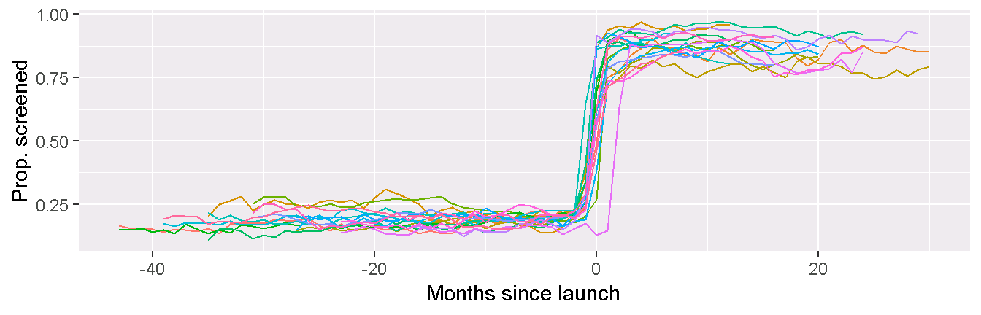
Interrupted Time Series: Screening
Alcohol screening rates: 22 primary care sites
Notes:
However, with the 5-6 months of practice coaching we spent with teams, we were able to implement and sustain changes. This graph is an example of how alcohol screening rates with the AUDIT-C increased dramatically and were sustained across our 22 primary care sites.
The 0 near the middle of the graph represents the randomized launch dates for the sites. As you can see, the proportion of alcohol screening before launch was low across all sites, below 30%, and after launching, rates of screening were above 75% in all sites, sustaining even after the active 6 months of practice coaching ended in the teams.

Slide 90
Main Outcome: Prevention
Prevention Usual Care vs Intervention per 10,000 PC patients
 | UC | Intervention | p
Screened | 2081 | 8319 | < 0.0001
Most recent screen positive | 502 | 1802 | < 0.0001
High Positive | 54 | 148 | < 0.0001
Brief alcohol counseling | 11 | 57 | < 0.0001

Slide 91
Results: Prevention

Slide 92
Main Outcome: Treatment
Alcohol Treatment Usual Care vs Intervention per 10,000 PC patients
 | UC | Intervention | p
New AUD diagnosis at visit | 29 | 34 | 0.003
New AUD dx and initiated Tx | 6.1 | 7.8 | 0.042
AUD treatment engagement | 1.8 | 1.4 | 0.30

Slide 93
Results: AUD Assessment Cascade

Slide 94
Sensitivity Analyses
Expanded timeframes – no difference
Use of NCQA SBI codes – no difference
Adding telephone – no difference
“Real” treatment – no difference
Notes:
So what happened with alcohol screening and assessment for alcohol use disorder after coaches finished active implementation in the clinics? As I had mentioned earlier, prior to SPARC, alcohol screening was 19%. Post-implementation in July 2018, alcohol screening was at 88% for the 22 primary care sites, and this was sustained a year later at 89%. For AUD assessment with the alcohol symptom checklist, 64% of patients with high-risk alcohol use were assessed post-implementation in July 2018, and this increased to 71% in July 2019.
Results. There were 37,093 PC patient visits across the 22 clinics in 7/2018, and 63601 in 7/2019. Alcohol screening rates were 88% in 7/2018 and 89% in 7/2019. AUD assessment rates of high-risk patients were 64% in 7/2018, and 71% in 7/2019.
Depression Screen (PHQ-2) 56793 63601 89% Alcohol Screen (Audit-C) 56458 63601 89% Marijuana Screen 56547 63601 89% Other Drug Screen 56108 63601 88% PHQ-9 8822 9169 96% Columbia Suicide Risk (Target 90%) 316 357 89% Alcohol Symptom Checklist (yellow) 845 1187 71% Marijuana Symptom Checklist (purple) 2014 2591 78% Other Drugs Symptom Checklist
(purple) 655 900 73%

Slide 95
Sustainment
 | End of All Active Implementation (July 2018) | One Year Later (July 2019)
 | % | %
AUDIT-C Screening | 88 | 89
AUD Assessment | 64 | 71
Notes:
So what happened with alcohol screening and assessment for alcohol use disorder after coaches finished active implementation in the clinics? As I had mentioned earlier, prior to SPARC, alcohol screening was 19%. Post-implementation in July 2018, alcohol screening was at 88% for the 22 primary care sites, and this was sustained a year later at 89%. For AUD assessment with the alcohol symptom checklist, 64% of patients with high-risk alcohol use were assessed post-implementation in July 2018, and this increased to 71% in July 2019.
Results. There were 37,093 PC patient visits across the 22 clinics in 7/2018, and 63601 in 7/2019. Alcohol screening rates were 88% in 7/2018 and 89% in 7/2019. AUD assessment rates of high-risk patients were 64% in 7/2018, and 71% in 7/2019.
Depression Screen (PHQ-2) 56793 63601 89% Alcohol Screen (Audit-C) 56458 63601 89% Marijuana Screen 56547 63601 89% Other Drug Screen 56108 63601 88% PHQ-9 8822 9169 96% Columbia Suicide Risk (Target 90%) 316 357 89% Alcohol Symptom Checklist (yellow) 845 1187 71% Marijuana Symptom Checklist (purple) 2014 2591 78% Other Drugs Symptom Checklist
(purple) 655 900 73%

Slide 96
Opportunistic Evaluation Using Statewide Survey

Slide 97

Survey Evaluation Aim
To understand what patients took away from their appointments with their doctors working in the SPARC clinics

Slide 98
Methods Overview
Clinic-level data from a state-wide patient experience survey conducted in the middle of SPARC trial implementation (August-Nov. 2018)
Examined the impact of the intervention on patient-reported receipt of brief intervention.
  Specifically compare rates at 3 groups of sites based on implementation phase
  Usual care: surveyed before implementation
  Active Implementation: surveyed during implementation
  Sustainment: surveyed after implementation
Notes:
To do this we capitalized on clinic-level data available from a state-wide patient experience survey conducted in the middle of SPARC trial

Slide 99
Methods: Date Source and Sample
The Washington Health Alliance “Your Voice Matters” patient survey was administered in primary care clinics 8/2017 - 11/2017:
  A random sample of patients from each clinic were surveyed via email and mail
    Overall response rate = 26%
    Ns from SPARC clinics ranged from 93-172, mean N = 125.2
  Patients were eligible if they were 25 years or older with a PC visit 7/1/2016 - 5/31/2017
Washington Health Alliance, Your Voice Matters: Patient Experience with Primary Care Providers in Washington State, February 2018

Slide 100
Methods: Survey Alcohol Measures
The survey included:
Two questions assessing alcohol consumption:
  Past-year frequency of alcohol use: “How often did you have a drink containing alcohol?”
  Past-year frequency of heavy episodic drinking (HED): “How often did you have 5 or more drinks on one occasion?”
One question assessing BI, asked only among patients reporting any HED:
  “Has this provider or other health care provider advised you about drinking (to drink less or not to drink at all)?”
Burman et al., J Stud Alcohol, 2004

Slide 101
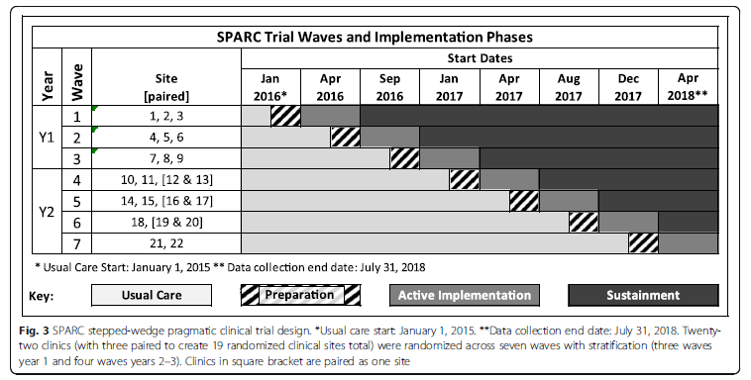
Methods: Timeline of Survey
Washington Health Alliance Survey 8/2017-11/2017
Notes:
As Amy and Kathy described, SPARC took place over 8 quarters between 2016 and 2018 as per this schema, which shows how sites were phased out of usual care (plain gray) and into preparation (striped) and then active implementation (dark grey) and finally followed to understand sustainment.
The Washington State Health Alliance survey was fielded between August and November of 2017, during the 6th quarter of SPARC.

Slide 102
Measure of Implementation Phase
Sites categorized into 3 Implementation Phases based on SPARC Phase at the time of survey:
Sustainment: surveyed after implementation (n=13)
Active Implementation: surveyed during implementation (n=3)
Usual Care/Preparation: surveyed before implementation (n=5)
Notes:
Based on the timeframe of the survey, and where clinics were with regard to implementation efforts at the time of survey, we categorized sites into 3 implementation phases.
Usual Care/Preparation, which included the 5 clinics in which implementation efforts hadn’t happened or were just being prepared at the time of the survey, Active Implementation, which included the 3 clinics in which implementation efforts were active, and Sustainment, which included the 13 clincs that were surveyed after implementation efforts

Slide 103
Methods Outcomes
We examined 2 different outcomes for each group of sites:
  Primary: Proportion reporting BI + any HED among all respondents
  Secondary: Proportion reporting BI among those reporting any HED

Slide 104
Analyses
Basic demographics and alcohol use patterns were described across all sites and for the three groups of sites specifically.
Modified Poisson regression models with robust variance estimation were used to:
  Obtain the prevalence and 95% confidence interval of primary and secondary outcomes across groups of clinics, and
  Estimate the relative rate of outcomes for sustainment and active implementation relative to both usual care and each other (between group differences)

Slide 105
Survey Sample
 | All Sites (N=2,629 patients) |  | Usual Care/ Prep (N=643 patients) | Active Imp. (N=375 patients) | Sustainment (N=1,611 patients)
 | N | % | % | % | %
Gender Female Male | 1,656 973 | 63.0 37.0 | 61.9 38.1 | 58.1 41.9 | 64.6 35.4
Age Group 25-34 35-44 45-54 55-64 56-74 75+ | 159 254 459 1,094 509 151 | 6.1 9.7 17.5 41.7 19.4 5.8 | 5.3 8.3 17.3 40.3 22.6 6.2 | 7.7 9.1 20.5 42.4 15.2 5.1 | 6.0 10.4 16.8 42.0 19.1 5.7
Any past-year drinking Overall Female* Male** | 1,753 1,071 682 | 66.7 64.7 70.1 | 65.9 65.3 66.9 | 69.6 67.9 72.0 | 66.3 63.8 70.9
Any past-year HED Overall In women In men | 441 193 248 | 16.8 11.7 25.5 | 14.5 8.8 23.7 | 19.5 14.2 26.8 | 17.1 12.2 25.9
Notes:
The sample was 63% female, and mostly over age 45
About 67% reported past-year drining, with slightly lower proportions in women than men, and about 17% reported past year heavy episodic drinking with large differences between women and men.

Slide 106
Survey Sample
 | All Sites (N=2,629 patients) |  | Usual Care/ Prep (N=643 patients) | Active Imp. (N=375 patients) | Sustainment (N=1,611 patients)
 | N | % | % | % | %
Gender Female Male | 1,656 973 | 63.0 37.0 | 61.9 38.1 | 58.1 41.9 | 64.6 35.4
Age Group 25-34 35-44 45-54 55-64 56-74 75+ | 159 254 459 1,094 509 151 | 6.1 9.7 17.5 41.7 19.4 5.8 | 5.3 8.3 17.3 40.3 22.6 6.2 | 7.7 9.1 20.5 42.4 15.2 5.1 | 6.0 10.4 16.8 42.0 19.1 5.7
Any past-year drinking Overall Female* Male** | 1,753 1,071 682 | 66.7 64.7 70.1 | 65.9 65.3 66.9 | 69.6 67.9 72.0 | 66.3 63.8 70.9
Any past-year HED Overall In women In men | 441 193 248 | 16.8 11.7 25.5 | 14.5 8.8 23.7 | 19.5 14.2 26.8 | 17.1 12.2 25.9
Notes:
Generally, samples were similar across groups of sites based on implementation phase.

Slide 107
Primary Survey Outcome:
% BI + HED among all respondents
Among all respondents, 6.9% reported BI and heavy episodic drinking
Notes:
With regards to our primary outcome--, 6.9% reported both brief intervention and heavy episodic drinking among all respondents.

Slide 108
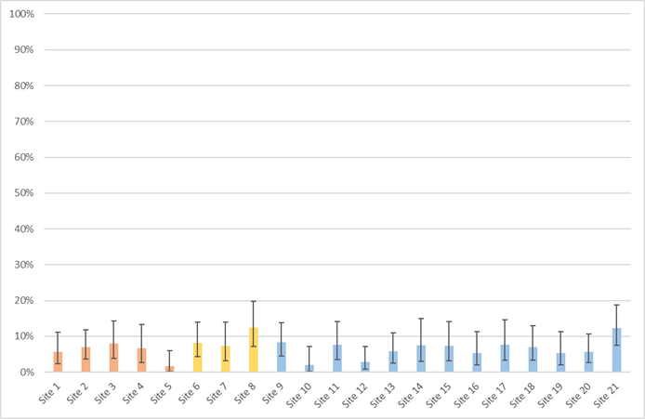
Primary Survey Outcome:
% BI + HED among all respondents
*Differences Not Significant
Overall p-value =0.06
Active
9.3% (5.3 – 8.3)
Usual Care
5.9% (4.3 – 8.1)
Sustainment
6.6% (5.2-8.3)
Notes:
As you can see, there was some variation in the prevalence of the primary outcome across clinics. When grouped by implementation phase, the proportion receiving brief intervention and reporting heavy episodic drinking among all respondents was 5.9% in the usual care sites who hadn’t yet implemented, 9.3% in the active implementation sitesand 6.6% in the sustainment sites who were surveyed after implementation.
The overall comparison suggested differences across groups of sites were not significant.

Slide 109
Primary Survey Outcome:
% BI + HED among all respondents
Overall differences in the primary outcome across groups of clinics were not significant (p=0.06)
  In between-group comparisons, the proportion of reported BI + HED among all respondents was:
Comparison | Risk Ratio | 95 % CI | p
Active Imp vs. usual care | 1.58 | 1.05 – 2.39 | 0.030
Sustainment vs. usual care | 1.12 | 0.77 – 1.65 | 0.550
Sustainment vs. Active Imp | 0.71 | 0.50 – 1.01 | 0.054
Notes:
While overall differences in the primary outcome across groups of sites were not significant at p=0.06, the proportion of reported BI + HED among all respondents was:
Significantly higher in sites in active implementation compared to sites in usual care BUT
No different between sites in sustainment and sites in usual care or between sites in sustainment relative to sites in active implementation

Slide 110
Secondary Survey Outcome:
% BI among all reporting HED
Among respondents who reported heavy episodic drinking, 40.8% reported receiving alcohol-related advice (brief intervention)
Notes:
With regards to our secondary outcome--, 40.8% reported brief intervention among those reporting heavy episodic drinking

Slide 111
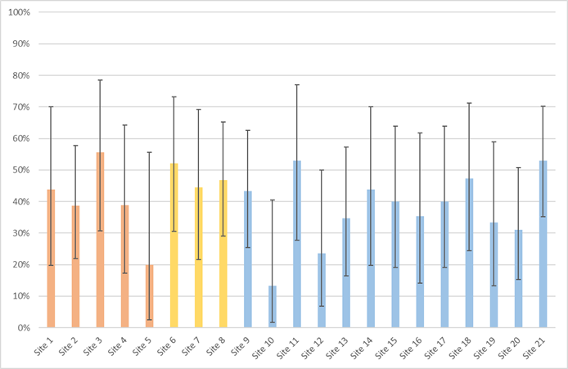
Secondary Survey Outcome:
% BI among all reporting HED
Usual Care
40.9 (34.0 – 49.1)
Active
49.9 (44.7 – 51.4)
Sustainment
38.9 (33.5 – 45.1)
*Differences Significant
Overall p-value =0.02
Notes:
Again, proportions of patients reporting BI among those reporting heavy episodic drinking varied across sites. for those in usual care, the prevalence of reported BI among those reporting HED was 40.9%, for those in active implementation the prevalence was 49.9%, and for those in the sustainment period, the prevalence was 38.9%. Overall differences in this secondary outcome were observed across groups of sites—the overall p-value was 0.02.

Slide 112
Secondary Survey Outcome:
% BI among all reporting HED
Overall differences in the secondary outcome across groups of sites were significant (p=0.02)
  In between-group comparisons, the proportion of reported BI among those with HED:
Comparison | Risk Ratio | 95 % CI | p
Active Imp vs. usual care | 1.17 | 0.96-1.43 | 0.111
Sustainment vs. usual care | 0.95 | 0.75-1.21 | 0.685
Sustainment vs. Active Imp | 0.81 | 0.69 – 0.96 | 0.012
Notes:
Overall differences in the secondary outcome across groups of sites were significant (p=0.02), but in between-group comparisons, the proportion of reported BI among those with HED:
Did not differ between sites in either active implementation or sustainment relative to sites in usual care/preparation, and
Was significantly lower for sites in sustainment relative to active implementation

Slide 113
Conclusions
Notes:
implementing alcohol-related care with Behavioral Health Integration
An Unexpected
(but probably lucky)
Behavioral Health Integration
to Improve the Relative Value
of the Innovation

Slide 114
SPARC Trial Achievements
High rates of sustained
  Alcohol screening – 89%
  DSM-5 assessment for AUDs – 71%
Small increase in BI: 1%→ 5%
  41% patient report
No increase in treatment engagement despite
  Increased new AUD diagnosis
  Increased treatment initiation
Possible increase in BI during practice coaching
  Bobb IJERPH 2017; Glass Implementation Science 2018
Notes:
Hemming, K., K. Carroll, J. Thompson, A. Forbes, M. Taljaard and S.-C. r. group (2018). "Quality of stepped-wedge trial reporting can be reliably assessed using an updated CONSORT: crowd-sourcing systematic review." J Clin Epidemiol.
Hemming, K., M. Taljaard and A. Forbes (2018). "Modeling clustering and treatment effect heterogeneity in parallel and stepped-wedge cluster randomized trials." Stat Med 37(6): 883-898.
Hemming, K., M. Taljaard, J. E. McKenzie, R. Hooper, A. Copas, J. A. Thompson, M. Dixon-Woods, A. Aldcroft, A. Doussau, M. Grayling, C. Kristunas, C. E. Goldstein, M. K. Campbell, A. Girling, S. Eldridge, M. J. Campbell, R. J. Lilford, C. Weijer, A. B. Forbes and J. M. Grimshaw (2018). "Reporting of stepped wedge cluster randomised trials: extension of the CONSORT 2010 statement with explanation and elaboration." BMJ 363: k1614.
Hughes, J. P., T. S. Granston and P. J. Heagerty (2015). "Current issues in the design and analysis of stepped wedge trials." Contemp Clin Trials 45(Pt A): 55-60.
Hussey, M. A. and J. P. Hughes (2007). "Design and analysis of stepped wedge cluster randomized trials." Contemp Clin Trials 28(2): 182-191.
Hussey, M. A. and J. P. Hughes (2007). "Design and analysis of stepped wedge cluster randomized trials." Contemp Clin Trials 28(2): 182-191.
One thing to point out is that I noticed a few places where the results from our pre-specified generalized linear mixed effect model (GLMM) that includes a random intercept for both site and person was very different from the corresponding generalized linear model (GLM) that does not include the random intercepts. This occurred for a few outcomes (namely trt_outcome_main) where the model claims to have converged, but the inconsistently with the GLM results makes me very skeptical. I've tried running other optimization algorithms but many of them failed to converge. As I've mentioned, the model is complicated to fit because it has 2 different random effects and the dataset is really large (~1.4 million records).

Slide 115
SPARC Trial Limitations
Single integrated system
Research funding
No real time performance feedback on main outcomes
Only 1 hour allowed for PCP training (all BHI)
Many alcohol-related discussions likely not documented
  Bobb IJERPH 2017; Glass Implementation Science 2018
Notes:
Hemming, K., K. Carroll, J. Thompson, A. Forbes, M. Taljaard and S.-C. r. group (2018). "Quality of stepped-wedge trial reporting can be reliably assessed using an updated CONSORT: crowd-sourcing systematic review." J Clin Epidemiol.
Hemming, K., M. Taljaard and A. Forbes (2018). "Modeling clustering and treatment effect heterogeneity in parallel and stepped-wedge cluster randomized trials." Stat Med 37(6): 883-898.
Hemming, K., M. Taljaard, J. E. McKenzie, R. Hooper, A. Copas, J. A. Thompson, M. Dixon-Woods, A. Aldcroft, A. Doussau, M. Grayling, C. Kristunas, C. E. Goldstein, M. K. Campbell, A. Girling, S. Eldridge, M. J. Campbell, R. J. Lilford, C. Weijer, A. B. Forbes and J. M. Grimshaw (2018). "Reporting of stepped wedge cluster randomised trials: extension of the CONSORT 2010 statement with explanation and elaboration." BMJ 363: k1614.
Hughes, J. P., T. S. Granston and P. J. Heagerty (2015). "Current issues in the design and analysis of stepped wedge trials." Contemp Clin Trials 45(Pt A): 55-60.
Hussey, M. A. and J. P. Hughes (2007). "Design and analysis of stepped wedge cluster randomized trials." Contemp Clin Trials 28(2): 182-191.
Hussey, M. A. and J. P. Hughes (2007). "Design and analysis of stepped wedge cluster randomized trials." Contemp Clin Trials 28(2): 182-191.
One thing to point out is that I noticed a few places where the results from our pre-specified generalized linear mixed effect model (GLMM) that includes a random intercept for both site and person was very different from the corresponding generalized linear model (GLM) that does not include the random intercepts. This occurred for a few outcomes (namely trt_outcome_main) where the model claims to have converged, but the inconsistently with the GLM results makes me very skeptical. I've tried running other optimization algorithms but many of them failed to converge. As I've mentioned, the model is complicated to fit because it has 2 different random effects and the dataset is really large (~1.4 million records).

Slide 116
Survey Evaluation Limitations
Survey response rate low
41% ~ VA rate of BI before implementation
Survey: no a priori hypothesis re “active” group
Notes:
Hemming, K., K. Carroll, J. Thompson, A. Forbes, M. Taljaard and S.-C. r. group (2018). "Quality of stepped-wedge trial reporting can be reliably assessed using an updated CONSORT: crowd-sourcing systematic review." J Clin Epidemiol.
Hemming, K., M. Taljaard and A. Forbes (2018). "Modeling clustering and treatment effect heterogeneity in parallel and stepped-wedge cluster randomized trials." Stat Med 37(6): 883-898.
Hemming, K., M. Taljaard, J. E. McKenzie, R. Hooper, A. Copas, J. A. Thompson, M. Dixon-Woods, A. Aldcroft, A. Doussau, M. Grayling, C. Kristunas, C. E. Goldstein, M. K. Campbell, A. Girling, S. Eldridge, M. J. Campbell, R. J. Lilford, C. Weijer, A. B. Forbes and J. M. Grimshaw (2018). "Reporting of stepped wedge cluster randomised trials: extension of the CONSORT 2010 statement with explanation and elaboration." BMJ 363: k1614.
Hughes, J. P., T. S. Granston and P. J. Heagerty (2015). "Current issues in the design and analysis of stepped wedge trials." Contemp Clin Trials 45(Pt A): 55-60.
Hussey, M. A. and J. P. Hughes (2007). "Design and analysis of stepped wedge cluster randomized trials." Contemp Clin Trials 28(2): 182-191.
Hussey, M. A. and J. P. Hughes (2007). "Design and analysis of stepped wedge cluster randomized trials." Contemp Clin Trials 28(2): 182-191.
One thing to point out is that I noticed a few places where the results from our pre-specified generalized linear mixed effect model (GLMM) that includes a random intercept for both site and person was very different from the corresponding generalized linear model (GLM) that does not include the random intercepts. This occurred for a few outcomes (namely trt_outcome_main) where the model claims to have converged, but the inconsistently with the GLM results makes me very skeptical. I've tried running other optimization algorithms but many of them failed to converge. As I've mentioned, the model is complicated to fit because it has 2 different random effects and the dataset is really large (~1.4 million records).

Slide 117
SPARC Trial Achievements
First step in improving alcohol-related care
  Bobb IJERPH 2017; Glass Implementation Science 2018
Notes:
Common barriers and facilitators

Slide 118
SPARC Trial: Conclusions
4 Key Facilitators
Practice coaching: target stigma and knowledge
Using local positive stories to overcome clinician resistance → tipping point
Integrate alcohol-related care with other integrated mental health care
Adding integrated behavioral health clinicians
  Bobb IJERPH 2017; Glass Implementation Science 2018
Notes:
Common barriers and facilitators

Slide 119
SPARC Trial Next Steps
How to increase preventive BIs?
Education
Performance measures using patient experience surveys
How to increasing engagement in AUD care
Continue de-stigmatization
Offer options: shared decision-making
  Bobb IJERPH 2017; Glass Implementation Science 2018
Notes:
Hemming, K., K. Carroll, J. Thompson, A. Forbes, M. Taljaard and S.-C. r. group (2018). "Quality of stepped-wedge trial reporting can be reliably assessed using an updated CONSORT: crowd-sourcing systematic review." J Clin Epidemiol.
Hemming, K., M. Taljaard and A. Forbes (2018). "Modeling clustering and treatment effect heterogeneity in parallel and stepped-wedge cluster randomized trials." Stat Med 37(6): 883-898.
Hemming, K., M. Taljaard, J. E. McKenzie, R. Hooper, A. Copas, J. A. Thompson, M. Dixon-Woods, A. Aldcroft, A. Doussau, M. Grayling, C. Kristunas, C. E. Goldstein, M. K. Campbell, A. Girling, S. Eldridge, M. J. Campbell, R. J. Lilford, C. Weijer, A. B. Forbes and J. M. Grimshaw (2018). "Reporting of stepped wedge cluster randomised trials: extension of the CONSORT 2010 statement with explanation and elaboration." BMJ 363: k1614.
Hughes, J. P., T. S. Granston and P. J. Heagerty (2015). "Current issues in the design and analysis of stepped wedge trials." Contemp Clin Trials 45(Pt A): 55-60.
Hussey, M. A. and J. P. Hughes (2007). "Design and analysis of stepped wedge cluster randomized trials." Contemp Clin Trials 28(2): 182-191.
Hussey, M. A. and J. P. Hughes (2007). "Design and analysis of stepped wedge cluster randomized trials." Contemp Clin Trials 28(2): 182-191.
One thing to point out is that I noticed a few places where the results from our pre-specified generalized linear mixed effect model (GLMM) that includes a random intercept for both site and person was very different from the corresponding generalized linear model (GLM) that does not include the random intercepts. This occurred for a few outcomes (namely trt_outcome_main) where the model claims to have converged, but the inconsistently with the GLM results makes me very skeptical. I've tried running other optimization algorithms but many of them failed to converge. As I've mentioned, the model is complicated to fit because it has 2 different random effects and the dataset is really large (~1.4 million records).

Slide 120

Options Study:
Patient
Decision
Aid
NIAAA R21 AA023037

Slide 121

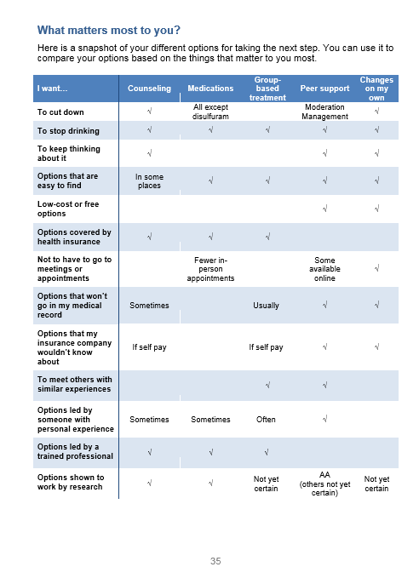
Stories
Destigmatize
& Engage
Option Grid:
5 Types of
Treatment
Worksheet
Share with PCP
NIAAA R21 AA023037

Slide 122
SPARC Trial Next Steps
Michigan SPARC
Partnered with Altarum
Stepped-wedge trial in 125 PC clinics:
  1-10 PC providers
  Not part of integrated system
  No screening
  No co-located mental health
  ~10 EHRs
AHRQ – R18 HS027076

Slide 123
SPARC Trial Next Steps
Michigan SPARC: 125 clinics – 6 waves
Adds approaches to PCP engagement
  Continuing education credit
  Maintenance of certification credit (required quality improvement for credentialing)
  Align with national quality improvement metrics that have financial incentives
Decision aid tested in random 50% of sites
AHRQ – R18 HS027076

Slide 124
Thank You!
Questions and Comments?

Slide 125
Results: AUD Assessment Cascade

Slide 126
Main Outcome: Prevention
Percent of Eligible
 | Usual Care | Intervention
Screened | 27.3 | 86.0
High Positive | 35.2 | 29.1
Brief intervention | 11.6 | 4.6

Slide 127
Sensitivity Analyses
BI in patients with positive AUDIT-C (> 2 W; >3 men) UC I
% %
BI: Main within 14 days 5.30 39.8
BI main within 60 days 5.31 39.9
BI in PC within 14 days 5.30 39.7
NCQA definition within 60 days 2.96 38.5
Notes:
Sensitivity (explanatory) measures identified a priori were used to assess whether our main findings were sensitive to the choices and assumptions of our main measures (Table X). We evaluated three sensitivity measures for prevention: use of the follow-up measures used in the HEDIS Alcohol Screening and Follow-up (ASF) measure (without NLP); use of a longer 60-day time frame for alcohol counseling consistent with that HEDIS measure; and limiting alcohol counseling to occur in primary care only. We also evaluated three a priori sensitivity measures for treatment: expanding treatment to include phone visits with AOD diagnoses; a longer timeframe of initiation in 30 days and engagement in the following 60 days; and changing treatment to include AUD medication fills and limiting in-person visits with AOD diagnoses to behavioral health and specialty chemical dependency treatment programs. Table X shows which were pre-specified a priori sensitivity measures.
(Note Amy Table 1 has columns for definition timeframe and setting (in person or telephone care included) and whether it was specified a priori (Joes paper) or added after review of the results.
BIDeliver_NCQA2 bi sensitivity 0 Flag for a positive screen in prior year and BI NCQA-defined within 60 days
BIDeliver_PC4 bi sensitivity 0 Flag for a pos screen in prior year and BI Main outcome in PRIMARY CARE in 14 dys
BIDeliver_Main60 bi sensitivity 0 Flag for a positive screen in prior year AND BI outcome within 60 days
bi_Main1 505 2447 5.30 39.8
bi_NCQA2 282 2369 2.96 38.5
bi_PC4 505 2446 5.30 39.7
bi_Main60 506 2457 5.31 39.9
We also evaluated three a priori sensitivity measures for treatment: expanding treatment to include phone visits with AOD diagnoses; a longer timeframe of initiation in 30 days and engagement in the following 60 days; and changing treatment to include AUD medication fills and limiting in-person visits with AOD diagnoses to behavioral health and specialty chemical dependency treatment programs.

Slide 128
Descriptive Results: Treatment

Slide 129
Sensitivity Analyses
Repeated analyses moving sites that were “almost done” with implementation from the sustainment to the active implementation group.
  For both primary and secondary outcomes, there were no significant differences across the 3 phases, and no significant between-group comparisons.
Repeated analyses comparing sites in sustainment + active implementation sites to sites in usual care/preparation (2 groups instead of 3).
  For both primary and secondary outcomes, there were no significant differences across the 2 phases, and no significant between group differences.

Slide 130
SPARC Trial: Descriptive Analyses
“Treatment Cascade”
Intervention patients only
#s who achieved each successive step in care
Notes:
Hemming, K., K. Carroll, J. Thompson, A. Forbes, M. Taljaard and S.-C. r. group (2018). "Quality of stepped-wedge trial reporting can be reliably assessed using an updated CONSORT: crowd-sourcing systematic review." J Clin Epidemiol.
Hemming, K., M. Taljaard and A. Forbes (2018). "Modeling clustering and treatment effect heterogeneity in parallel and stepped-wedge cluster randomized trials." Stat Med 37(6): 883-898.
Hemming, K., M. Taljaard, J. E. McKenzie, R. Hooper, A. Copas, J. A. Thompson, M. Dixon-Woods, A. Aldcroft, A. Doussau, M. Grayling, C. Kristunas, C. E. Goldstein, M. K. Campbell, A. Girling, S. Eldridge, M. J. Campbell, R. J. Lilford, C. Weijer, A. B. Forbes and J. M. Grimshaw (2018). "Reporting of stepped wedge cluster randomised trials: extension of the CONSORT 2010 statement with explanation and elaboration." BMJ 363: k1614.
Hughes, J. P., T. S. Granston and P. J. Heagerty (2015). "Current issues in the design and analysis of stepped wedge trials." Contemp Clin Trials 45(Pt A): 55-60.
Hussey, M. A. and J. P. Hughes (2007). "Design and analysis of stepped wedge cluster randomized trials." Contemp Clin Trials 28(2): 182-191.
Hussey, M. A. and J. P. Hughes (2007). "Design and analysis of stepped wedge cluster randomized trials." Contemp Clin Trials 28(2): 182-191.
One thing to point out is that I noticed a few places where the results from our pre-specified generalized linear mixed effect model (GLMM) that includes a random intercept for both site and person was very different from the corresponding generalized linear model (GLM) that does not include the random intercepts. This occurred for a few outcomes (namely trt_outcome_main) where the model claims to have converged, but the inconsistently with the GLM results makes me very skeptical. I've tried running other optimization algorithms but many of them failed to converge. As I've mentioned, the model is complicated to fit because it has 2 different random effects and the dataset is really large (~1.4 million records).

Slide 131
SPARC Trial – 25 PC Clinics
Pragmatic Trial of Alcohol SBI and Shared Decision-Making for Alcohol Use Disorders
Duration: months | 3 | 12 | 4 | 4 | 4 | 4 | 4 | 4
Preparation
Pilot – 3 clinics |  | Pilot
Wave 1 – 3 clinics |  |  | 1
Wave 2 – 3 clinics |  |  |  | 2
Wave 3 – 3 clinics |  |  |  |  | 3
Wave 4 – 2-4 clinics |  |  |  |  |  | 4
Wave 5 – 2-4 clinics |  |  |  |  |  |  | 5
Wave 6 – 2-4 clinics |  |  |  |  |  |  |  | 6
Wave 7 – 2-4 clinics |  |  |  |  |  |  |  |  | 7

Slide 132
SPARC Implementation Intervention
EHR Tools
Check-in staff, MA: Screening, AUD symptom assessment
Provider: AUD treatment initiation
Performance Feedback
Screening
AUD symptom assessment
AUD treatment initiation
PC Team
Front desk
MA, PCP, SW, RN
Practice Coach
Clinical care content
Stigma reduction
Workflow refinement
Quality improvement
Notes:
132
The SPARC implementation intervention included three implementation strategies to support front line primary care teams. These were:
One, electronic decision support tools in our EHR
These included prompts for check-in staff and medical assistant to screen patients, and medical assistants to assess patients at high-risk for AUD with an AUD symptom checklist
As well as a prompt for providers for AUD treatment initiation
The second implementation strategy included performance monitoring and feedback, which included screening, assessment of AUD symptoms, and AUD treatment initiation at the clinic and provider-level
And last, a practice coach helped to support primary care teams with clinical care content, stigma reduction, development and refinement of workflow, and quality improvement.
Some gratuitous foreshadowing here is that I want to note that there were no decision support tools or performance monitoring and feedback built around brief intervention and treatment engagement, which were part of the main outcomes.

Slide 133
SPARC Trial: What Happened?
Implemented as Behavioral Health Integration
7-item paper screener – MA entered → EHR
Assess on paper MA – entered → EHR
  PHQ-9 for depression, Suicide Risk Assessment
  DSM-5 symptom checklists: alcohol & other SU
Approval initially for only year 1 (9 sites)
  Bobb IJERPH 2017; Glass Implementation Science 2018
Notes:
Hemming, K., K. Carroll, J. Thompson, A. Forbes, M. Taljaard and S.-C. r. group (2018). "Quality of stepped-wedge trial reporting can be reliably assessed using an updated CONSORT: crowd-sourcing systematic review." J Clin Epidemiol.
Hemming, K., M. Taljaard and A. Forbes (2018). "Modeling clustering and treatment effect heterogeneity in parallel and stepped-wedge cluster randomized trials." Stat Med 37(6): 883-898.
Hemming, K., M. Taljaard, J. E. McKenzie, R. Hooper, A. Copas, J. A. Thompson, M. Dixon-Woods, A. Aldcroft, A. Doussau, M. Grayling, C. Kristunas, C. E. Goldstein, M. K. Campbell, A. Girling, S. Eldridge, M. J. Campbell, R. J. Lilford, C. Weijer, A. B. Forbes and J. M. Grimshaw (2018). "Reporting of stepped wedge cluster randomised trials: extension of the CONSORT 2010 statement with explanation and elaboration." BMJ 363: k1614.
Hughes, J. P., T. S. Granston and P. J. Heagerty (2015). "Current issues in the design and analysis of stepped wedge trials." Contemp Clin Trials 45(Pt A): 55-60.
Hussey, M. A. and J. P. Hughes (2007). "Design and analysis of stepped wedge cluster randomized trials." Contemp Clin Trials 28(2): 182-191.
Hussey, M. A. and J. P. Hughes (2007). "Design and analysis of stepped wedge cluster randomized trials." Contemp Clin Trials 28(2): 182-191.
One thing to point out is that I noticed a few places where the results from our pre-specified generalized linear mixed effect model (GLMM) that includes a random intercept for both site and person was very different from the corresponding generalized linear model (GLM) that does not include the random intercepts. This occurred for a few outcomes (namely trt_outcome_main) where the model claims to have converged, but the inconsistently with the GLM results makes me very skeptical. I've tried running other optimization algorithms but many of them failed to converge. As I've mentioned, the model is complicated to fit because it has 2 different random effects and the dataset is really large (~1.4 million records).

Slide 134
SPARC Trial: What Happened?
Social workers
  Transitioned to integrated MH clinicians
  Number expanded during trial
  Warm hand-offs key to success
  Bobb IJERPH 2017; Glass Implementation Science 2018
Notes:
Hemming, K., K. Carroll, J. Thompson, A. Forbes, M. Taljaard and S.-C. r. group (2018). "Quality of stepped-wedge trial reporting can be reliably assessed using an updated CONSORT: crowd-sourcing systematic review." J Clin Epidemiol.
Hemming, K., M. Taljaard and A. Forbes (2018). "Modeling clustering and treatment effect heterogeneity in parallel and stepped-wedge cluster randomized trials." Stat Med 37(6): 883-898.
Hemming, K., M. Taljaard, J. E. McKenzie, R. Hooper, A. Copas, J. A. Thompson, M. Dixon-Woods, A. Aldcroft, A. Doussau, M. Grayling, C. Kristunas, C. E. Goldstein, M. K. Campbell, A. Girling, S. Eldridge, M. J. Campbell, R. J. Lilford, C. Weijer, A. B. Forbes and J. M. Grimshaw (2018). "Reporting of stepped wedge cluster randomised trials: extension of the CONSORT 2010 statement with explanation and elaboration." BMJ 363: k1614.
Hughes, J. P., T. S. Granston and P. J. Heagerty (2015). "Current issues in the design and analysis of stepped wedge trials." Contemp Clin Trials 45(Pt A): 55-60.
Hussey, M. A. and J. P. Hughes (2007). "Design and analysis of stepped wedge cluster randomized trials." Contemp Clin Trials 28(2): 182-191.
Hussey, M. A. and J. P. Hughes (2007). "Design and analysis of stepped wedge cluster randomized trials." Contemp Clin Trials 28(2): 182-191.
One thing to point out is that I noticed a few places where the results from our pre-specified generalized linear mixed effect model (GLMM) that includes a random intercept for both site and person was very different from the corresponding generalized linear model (GLM) that does not include the random intercepts. This occurred for a few outcomes (namely trt_outcome_main) where the model claims to have converged, but the inconsistently with the GLM results makes me very skeptical. I've tried running other optimization algorithms but many of them failed to converge. As I've mentioned, the model is complicated to fit because it has 2 different random effects and the dataset is really large (~1.4 million records).

Slide 135
Practice coaching schedule
Clinic leadership meeting (3 months before kickoff)
Leaders do quarterly PDCAs with teams monthly data
3-hour kickoff meeting
1-hour training: all primary care
2x1 hour trainings: PCP/RN and MA/check-in staff
Launch
Sustainment
 |  | Weeks
 |  | 1 | 2 | 3 | 4 | 5 | 6 | 7 | 8 | 9 | 10 | 11 | 12 | 13 | 14 | 15 | 16 | 17 | 18 | 19 | 20 | 21 | 22 | 23 | 24 | 25 +
 |  | Preparation |  |  |  |  |  |  |  | Active Implementation
1-hour weekly plan-do-check-adjust (PDCA) meetings with teams
1-hour weekly PDCA meetings with teams; monthly with leaders
1-hour 2x/month PDCA meetings with teams; monthly with leaders
Notes:
Despite this discontent, with our health system partners’ support, we were able to ask for clinical time to implement this work, likely because we were rolling out this larger initiative of behavioral health integration and not just alcohol-related care.
This is a general schedule of the meetings that practice coaches had with each clinic, and I’ll walk you through this.

Slide 136
Practice coaching schedule
Meet w/ clinic leaders
3-hour kickoff meeting
All staff training: 1 hour
Separate trainings: 1 hour PCP/RN & MA/front desk
Launch
Sustainment
 |  | Weeks
 |  | 1 | 2 | 3 | 4 | 5 | 6 | 7 | 8 | 9 | 10 | 11 | 12 | 13 | 14 | 15 | 16 | 17 | 18 | 19 | 20 | 21 | 22 | 23 | 24 | 25 +
 |  | Preparation |  |  |  |  |  |  |  | Active Implementation
Weekly meetings
Meetings: weekly to every other week
Monthly with leaders
Notes:
Roll out started with a meeting with clinic leadership. This was usually 2-3 months before the kick-off meeting with a goal of asking leaders to identify local implementation team members, and to discuss implementation schedule. Each clinic’s local implementation team consisted of an interdisciplinary team comprised of the primary care chief and manager, Provider and Medical Assistant dyads, Front desk check-in staff, Social worker: integrated behavioral health specialist in primary care, and Nurse
We had a 2.5-3 hour kick off meeting with the local implementation team and leaders to give an overview of the work with a goal of piloting by the end. This was followed by weekly one hour quality improvement meetings which we call plan-do-check-adjust cycle, or PDCA cycle meetings with the teams, with a focus on refining work flow, planning for a full clinic launch, and improving the clinical knowledge gap.
Before launch, there were also a series of three trainings led by the practice coaches. This included a 1-hour all primary care training, and one hour primary care provider and RN training and a separate 1-hour medical assistant and check-in staff training.
Weekly hourly PDCA meetings continued for the 3 months after launch using performance feedback data, and clinic and operations leaders joined these meetings monthly. These weekly meetings generally ramped down around the last month of active implementation.
At the last PDCA meeting with leaders, practice coaches handed off clinics to operations leaders, who continued to meet quarterly with clinics, providing monthly data.

Slide 137



Secondary Evaluation of the Sustained Patient-centered Alcohol-related Care (SPARC) Trial:
Patient Reported Advice Across Primary Care Sites at Three Phases of Implementation
Emily C. Williams, PhD, MPH
Emily.Williams3@va.gov
VA Puget Sound Health Services Research & Development
Center of Innovation for Veteran-Centered and Value-Driven Care
Department of Health Services, University of Washington

Slide 138
Acknowledgments
Collaborators
Research Funding
Madeline C. Frost, MPH
Amy K. Lee, MPH
Jennifer F. Bobb, PhD
Julie E. Richards, PhD, MPH
Evette J. Ludman, PhD
Carol E. Achtmeyer, ARNP
Malia Oliver
Ryan M. Caldeiro, MD, MPH
Rebecca Parrish, MSW
Joseph E. Glass, PhD, MSW
Paula Lozano, MD, MPH
Katharine A. Bradley, MD, MPH
  Agency for Healthcare Research and Quality (AHRQ) R18 HS023173
  National Institute on Alcohol Abuse and Alcoholism (NIAAA) K24 AA022128
  National Institute on Alcohol Abuse and Alcoholism (NIAAA) K01 AA023859
Other Support
  Washington Health Alliance

Slide 139
Background
The Sustained Patient-centered Alcohol-related Care (SPARC) trial tested state-of-the-art implementation strategies and identified:
  Small but significant improvement in electronic health record (EHR)-documented brief alcohol intervention associated with the implementation intervention
Results encouraging although rates of documented BI still very low post-implementation (5%)
EHR documentation may under-estimate receipt of BI
Bradley KA and Lee AK—previous talks

Slide 140
Limitations
Response rate was low
Clinic-level, aggregate data limited our power to detect associations
Some clinics may have been misclassified in respective implementation groups at the time of the survey
Patient-reported measures may be subject to recall or social-desirability bias

Slide 141
Conclusions
Rates of patient-reported brief intervention were higher than the 5% identified based on EHR documentation in the main trial, which is promising.
Outcomes were largely similar across implementation phases, but findings are suggestive that BI was provided most often while the practice coach was in the clinic.
Notes:
Rates of the primary outcome were higher in active implementation sites than usual care sites and rates of the secondary outcome were higher in active implementation than sustainment sites

Slide 142
Implications
As in the main trial, results support further quality improvement efforts to ensure patients with unhealthy alcohol use receive brief intervention.
  These efforts may focus on encouraging clinic staff to carry out roles of the practice coach, including focusing on brief intervention

Slide 143
Background
Patient report is often used to assess receipt of preventive counseling (e.g., smoking cessation counseling)
Assessment of an independent patient-report measure could provide further understanding of the influence of the SPARC implementation intervention.
Flocke and Stange, 2004

Slide 144
Formative Evaluation
Resistance universal at the start in each clinic
Tipping point usually due to local stories
All tools on a clinical website and in print services for ordering
Attitudinal shift in health system leaders
Notes:
However, we were able to achieve a huge culture shift. In 2018, as active implementation of SPARC in the context of Behavioral Health Integration was winding down, providers ranked behavioral health integration in the top 5 of 21 primary care investments to improve patient experience, quality of care, decrease costs, and improve provider experience. Another achievement is this change has been sustained a year after active support by the practice coaches ended, and the health system owns the alcohol-related care.
Culture shift –
PC clinician perceptions
July-August 2018
PC providers survey: 21 “PC investments”
130/435 (30%) responded
Behavioral Health Integration in the top 5
Impact on patient experience: 2nd (44%)
Impact on provider experience: 5th (27%)
Improved quality: 3rd (38%)
Decreased costs: 4th (17%)

Slide 145
SPARC Implementation Intervention
Three Implementation Strategies
  EHR tools
  Performance monitoring and feedback
  Practice facilitation (coaching) …
    Quality improvement by local team
    Stigma reduction: video & handout
    Improved knowledge & understanding
  Bobb IJERPH 2017; Glass Implementation Science 2018
  https://www.youtube.com/watch?v=tbKbq2IytC4

Slide 146
SPARC Implementation Intervention
Three Implementation Strategies
  EHR tools
  Performance monitoring and feedback
  Bobb IJERPH 2017; Glass Implementation Science 2018
  https://www.youtube.com/watch?v=tbKbq2IytC4

Slide 147
Results: Prevention

Slide 148
Results: AUD Treatment Cascade

Slide 149
Descriptive Results: Treatment
33%
44%

